Slide 1
Overview of the Team Around the Learner approach
Module 4
The role of the Lead Professional

Slide 2
Module 4: The role of the Lead Professional
Overview
The aim of this module is to help Lead Professionals identify and bring together the right team for a Team Around the Learner approach. The module also outlines how to work with different stakeholders and how to build, manage and maintain successful relationships. It supports the Lead Professional to facilitate effective Team Around the Learner meetings.
Focus
This module will support your understanding of:
4. How to lead a team of people to coordinate the work required to support a learner with complex needs
Engaging the right team and bringing them together
Building successful relationships to support a high functioning team
Working with different stakeholders
Organising meetings and facilitating effective discussion
Leading a culture of feedback and growth
Identifying the need to escalate team issues and asking for help

Slide 3
Engaging the right team and bringing them together
Having the right team in place to support the learner and their family through the Team Around the Learner approach is important in creating successful and sustainable outcomes.
Teams are made up of people who have natural, community and formal support relationships with the learner. Examples of team members include health professionals, education professionals, external community agencies, other government departments, relatives, friends and community members who are connected to the learner.
As learners and their needs are different, the composition of the team and the skills required will vary for each learner.
Engagement of the learner and family in building the team is the best practice.
The Lead Professional should explain the Team Around the Learner approach to team members and the important roles they can play.
The team should ensure that learning engagement is a priority goal throughout the process.

Slide 4
Engaging the right team and bringing them together Identifying and communicating team involvement.
A team approach
At different points in the Team Around the Learner approach, individuals will be identified and invited to join the learner's team. Contacting the team members may be undertaken by the Lead Professional on their own or with the learner and family.
The learner should feel involved in the process and given the choice but should not feel as though it is all their responsibility.
Identifying and contacting
As team members are invited, their levels of engagement and willingness to participate as part of the team should be ascertained.
Before joining the team, the Lead Professional should brief team members on:
The Team Around the Learner approach
What will be expected of them
How the Team Around the Learner approach will be conducted
Who will be involved in the Team Around the Learner
The time commitment involved
Ascertaining engagement
The Lead Professional should ascertain each individual’s commitment to the approach.
If there are team members who are less committed, the Lead Professional should explain further about the value of the process in the educational future of the learner.
Others in the team may also be able to support reluctant team members by drawing on the connections that they have developed with these team members.

Slide 5
Engaging the right team and bringing them together
Who is involved and how?
This approach recognises that for each learner, the focus and complexity of need will be different. This will impact on the composition and membership of the team and the choice of Lead Professional. It is the Lead Professional’s role to collate and share team details in the team details form.
Here are some questions to consider when forming the team:
Who / which agencies are already involved?
Who else needs to be involved?
How can we share information and planning on a needs to know basis?
Can each team member commit the time and effort required?
Individual members may not always be able to participate
There may be circumstances where individuals identified as potential team members are not able to participate for a number of reasons, which include:
Conflict of interest
Time
Capability
Lack of understanding about what is involved
Where an individual cannot participate, an alternate person should be identified where appropriate.

Slide 6
Engaging the right team and bringing them together
Handover of the Lead Professional role:
If there needs to be a change in Lead Professional, there should be a clear process for transferring information. The process should be kept simple and follow an ISOBAR approach.
Where possible handovers should be conducted face-to-face to provide an opportunity to clarify information and hand over physical documentation. The person handing over the role should know what they have to communicate and have any relevant documentation ready.
Where possible, the learner and their family should attend the handover meeting so as to provide context to any information necessary.
There is no standardised format to a handover process for the purpose of Team Around the Learner but the following ISOBAR acronym can make the handover meeting meaningful.
I | Identify | Introduce yourself, the learner and their family
S | Situation | Describe the reason for the handover
O | Observations | Include any observations that have been made so far (including those that have been documented)
B | Background | Provide the background to the Team Around the Learner approach so far
A | Agree a plan | Agree on the next steps
R | Read back | Confirm a shared understanding
Notes:
Where there is a transition from the initial contact person to the Lead Professional, the initial contact person should arrange a handover meeting. This meeting should occur with the learner and family present so that they have the opportunity to provide any additional information where they feel necessary.
The initial contact person will often continue to be part of the team, as they are most likely someone who is working closely with the learner.

Slide 7
Building successful relationships to support a high functioning team
Teamwork is a fundamental element of the Team Around the Learner approach and can only be achieved through successful relationships. Successful relationships are dependent on rapport, trust, respect and open communication.
Trust & Respect
Belief in the reliability or ability of other team members, and their integrity.
Relationships in which people understand the perspectives and ideas of others, and communicate well with each other.
Open communication occurs when all team members are able to express ideas to one another.
Rapport
Open Communication
Teamwork

Slide 8
Building successful relationships to support a high functioning team - rapport
Teamwork
Rapport
Trust & Respect
Open Communication
Building rapport with the learner, family and team members will create a mutual relationship that is based on trust and agreement.
Rapport refers to a relationship in which people or groups understand each other’s ideas and communicate well with each other. It is important to create an environment where the learner, family and team members feel comfortable with each other and are able to communicate their feelings, ideas and experiences, knowing that they are being heard.
Techniques for building rapport in group situations include:
Visual
Vocal
Action
Maintaining eye contact when someone is speaking
Accurately interpreting body language (stance, facial expressions etc.)
Being approachable
Show empathy towards others
Find links between common experiences
Build on another person's ideas
Actively listen and respond to comments
Using techniques to ensure people feel comfortable
Do what you say you will do
Take an interest in team members
Establish open channels of communication

Slide 9
Building successful relationships to support a high functioning team – trust and respect
Teamwork
Rapport
Trust & Respect
Open Communication
Trust and respect form the foundation of successful relationships between the learner, family and team members.
Trust and respect should be valued and promoted. Positive behaviours will be able to be influenced and encouraged through:
promoting a culture of accepting contributions – there is no right or wrong answer
explaining your role to the learner, family and team members
focussing on making sure people are listened to and understood during meetings
being punctual and reliable in meetings and making sure information is provided in a timely manner
promoting shared goals and shared values
respecting confidentiality of information
promoting accountability for roles and responsibilities.
The Lead Professional may play a major role in ensuring that the expected behaviours are maintained throughout the Team Around the Learner approach.
These concepts can be reflected as ground rules to help build trust and respect.

Slide 10
Building successful relationships to support a high functioning team – open communication
Teamwork
Rapport
Trust & Respect
Open Communication
Open communication will promote positive conversations where there is no right
wrong answer.
Effective communication occurs when all team members are able to express ideas and actively participate in group discussion, brainstorming and open conversation. This is the opposite of closed communication when a few people dominate the discussion.
The Team Around the Learner approach relies on open communication to enable effective problem solving to occur. Below are some examples of promoting open communication within a team:
Create an environment that promotes open communication
Set open communication as one of the ground rules for team meetings
Make sure everyone understands the difference between open and closed communication
Recognise different communication styles in the team
Acknowledge that some people receive information differently e.g. visual, auditory, activity based
Demonstrate active listening by asking questions and clarifying comments
Encourage the sharing of information
Ask team members to share information, knowledge, ideas and experience
Discuss sessions learnt from past experiences
Use brainstorming
Promote positive conversations
There are no right or wrong answers
Keep messages positive and explain the benefits of activities for the learner

Slide 11
Building successful relationships to support a high functioning team
Learners, family and team members will have varying levels of engagement which can impact on the success of outcomes.
You may be faced with learners, families or team members who are somewhere on the scale between:
Disengaged Indifferent Complaint Engaged
Disengaged: Disinterested in the process and are often likely to be sceptical or openly negative. Disengagement can come in different forms depending on whether it is the learner, family or team members. These people are often not willing to persist and help make a change for the better; they will often withdraw from the team.
Indifferent: May not understand the importance or care about participating in a Team Around the Learner. This may be characterised by minimal involvement or participation during activities, a lack of sharing ideas or not being accountable for their responsibilities.
Compliant: Understand the importance of Team Around the Learner and will participate but will not be willing to go the extra mile.
Engaged: Understand Team Around the Learner and want to actively participate in activities to improve outcomes for the learner and family.

Slide 12
Building successful relationships to support a high functioning team
The Lead Professional may experience verbal or non verbal cues that identify team members along the scale.
The table below identifies some behavioural and emotional cues for individual levels of engagement and some sample techniques for working with them and getting them more engaged.
Disengaged
Indifferent Complaint Engaged
Emotional Outbreaks
Retaliation
No involvement in discussions
Allow the individual to express their frustration
Listen to their thoughts and provide empathy
Speak to a trusted team member
Lack of interest and involvement
Small or no involvement in discussions
Identify the underlying cause of indifference
Help create motivating goals that mean something to the individual
Some interest and involvement
Small or no involvement in discussions
Show that their ideas and contributions are valued
Provide positive and encouraging feedback
Actively involved and contribute fully
Participate in discussions
Effective involvement in discussions
Keep the individual highly involved in discussions and encourage ongoing participation

Slide 13
Building successful relationships to support a high functioning team
Team formation takes time and teams often go through recognisable stages as they change from being collections of strangers to becoming united groups with common goals.
The Forming, Storming, Norming, and Performing model describes the stages that a team typically goes through.
These dynamics can be particularly observable or heightened when a diverse range of team members are involved.
High-performing teams are highly focused on their learner’s goals and achieve superior results together than they would separately. In the storming and norming phase, the team understands the purpose of why they are coming together, learn how to interact together and resolve conflicts. When the team reaches the performing phase, they have highly effective behaviours that allow them to overachieve in comparison to regular teams.
Forming
Little agreement
Unclear purpose
Storming
Potential disagreements
Increased clarity of purpose
Norming
Clear vision and purpose
Focus on achievement
Performing
Agreement and consensus
Require guidance and direction
Power struggles
Clear roles and responsibilities
Facilitation
Support
Delegation
Adjourning
Task completion
Good feeling about achievements
Recognition of success
Notes:
Reference??

Slide 14
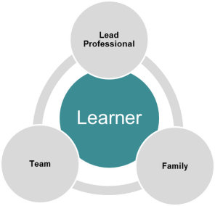
Working with different stakeholders– the learner In order to engage and work with the learner, it is important to establish a rapport.
Who is the learner?
When first engaging with the learner it is important to get an understanding of:
the background and history relevant to the Team Around the Learner approach
the family context
the learner’s personal strengths and concerns
what is important to the learner
hobbies and interests of the learner
How do I engage them?
The team should actively involve the learner and promote engagement throughout the Team Around the Learner approach. This can be done by:
Promoting the learner's voice and choices, ensuring that the team understands and values this input
Allowing the learner to participate fully and equally, by being able to truthfully voice any needs, goals, issues, or concerns
Actively listening to the learner

Slide 15
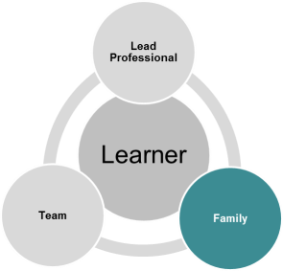
Working with different stakeholders– the family The family are important members of the Team Around the Learner as they provide perspective, understanding, insight and support.
Who is the learner?
When first engaging with the learner it is important to get an understanding of:
The background and history relevant to the Team Around the Learner approach
The family context
The learner’s personal strengths and concerns
What is important to the learner
Hobbies and interests of the learner
How do I engage them?
The team should actively involve the learner and promote engagement throughout the Team Around the Learner approach. This can be done by:
Promoting the learner's voice and choices, ensuring that the team understands and values this input
Allowing the learner to participate fully and equally, by being able to truthfully voice any needs, goals, issues, or concerns
Actively listening to the learner

Slide 16
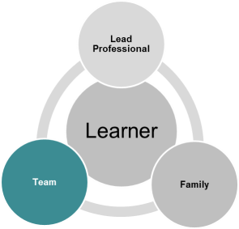
Working with different stakeholders– the team Team members come together collaboratively to promote improved outcomes for the learner
Who is the team?
Team members can include:
learner
education professionals
community agencies
other government departments
Relatives
family
community members
advocate
Student Support Services
How do I engage them?
The Team Around the Learner approach capitalises on the perspectives and commitment of all the team members involved in the process. The following principles can be used by the Lead Professional to meaningfully engage team members:
Encourage open and collaborative conversations for developing strategies and actions that are relevant and meaningful to both the learner and the family
Encourage feedback and the sharing of information, experience and knowledge
Establish efficient processes for the meaningful exchange of information and monitoring progress

Slide 17
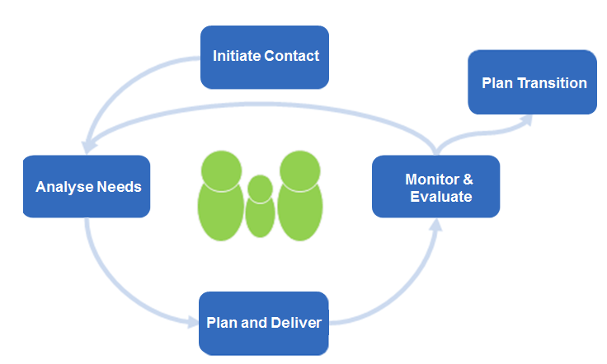
Organising meetings and facilitating effective discussion
Plan & Coordinate
Preparing for the planning meeting with the team.
The first step in the Plan and Coordinate Support phase is for the Lead Professional to schedule a planning meeting with the identified team members.
The purpose of the planning meeting is to:
For this to occur there are a number of activities that need to be facilitated by the Lead Professional as outlined in the Plan and Coordinate Support phase. The following slides discuss some techniques and tips for the Lead Professional in setting up the first meeting and facilitating effective discussions.
Develop an individualised plan that is person centred, family sensitive, strengths based and has input from all the team members including the learner.
It should be noted that more than one planning meeting may be required to develop the plan. Further meetings will be scheduled in the Monitor & Evaluate phase.

Slide 18
Organising meetings and facilitating effective discussion As the Lead Professional, you will need to prepare, facilitate and follow up after the meetings.
Before the Meeting
Planning will ensure that you are adequately prepared for the planning meeting Bring the right team of people together Schedule the meeting making sure everyone is available – if necessary make arrangements for an interpreter or aide Book a suitable location and set up the room on the day Develop an agenda with consideration for the learner and family in having an understanding of the purpose, approach and desired outcomes of the meeting
During the Meeting
Guide the team through activities and facilitate effective discussion whilst supporting the learner Sit with the learner and family Introduce the learner, family and team members to each other Run through the purpose, agenda, and desired outcomes Introduce the Team Around the Learner approach and the idea of person centred, family sensitive practice Facilitate the development of 'ground rules' for the team Facilitate the development of the plan Document the plan Agree on next meeting, actions responsibility owners and timelines
After the Meeting
Distribute the agreed plan Appropriately distribute the agreed plan, minutes and any relevant documents to the learner, family, and team
Notes:
Preparation is key. Planning before a team meeting will help make sure it is as effective as possible

Slide 19
Organising meetings and facilitating effective discussion
The set up of the room can either facilitate effective discussion or act as a barrier to it.
Team Around the Learner is a collaborative process grounded in ideas sharing between all team members.
The set up of the room should be open and allow all team members to see each other. This allows people to address the group easily and see everything. Ideally, people should not have desks in front of them in order to create more open dialogue.
Meetings with the team, particularly the planning meeting, will involve a lot of brainstorming and generation of ideas. Writing these down so that they can be seen by everyone helps with engagement, sharing ideas, acknowledgement of suggestions and effective discussions.
ROOM SET UP OPTIONS
PROP OPTIONS
White Board
Easy to see and use
Can get messy
FACE TO FACE
SEMI CIRCLE
Butchers Paper/Sticky Notes
Great for brain storming and grouping themes
Risk of losing notes
Computers & Projectors
No re-typing is required
May not always be available and difficult to see
FACE TO FACE FORMAT
Notes:
The meeting can be completed face to face in a semi circle format. This allows the team to get together and discuss topics and complete activities.
The Semi Circle is an informal room set up that remove barriers and allows for easy conversations
The Table Format is a more formal discussions.
The room set up is dependent on the room constraints.
Using interactive activities and approaches such as a white board and butchers papers, can help engage the learner, family and members to initiate effective discussions
Various tools and props can be used to help initiate effective discussions. These tools and props can help engage and involve the learner, family and team members.
These tools can be used in activities such as:
Discussing lessons learnt and successful strategies used in the past
Describing priorities of needs
Discussing the indicators of success
Defining strategies and actions
Assigning roles and responsibilities

Slide 20
Organising meetings and facilitating effective discussion
An agenda can be a useful tool for guiding the meeting and reducing uncertainty for the learner and family.
Before the meeting it may be useful to develop an agenda. This can help the learner and family's understanding of the process and reduce uncertainty during the meeting. It also acts as a useful guide for the Lead Professional during the meeting.
An agenda should include:
the date, time and location of the meeting
the attendees
the topics to be discussed
the timeframe for each topic
an actions or next steps section
The agenda can help you plan for each topic so that all topics are covered in the meeting.

Slide 21
Organising meetings and facilitating effective discussion The Team Around the Learner Key Principles should guide the behaviour and activities of the Team Around the Learner approach.
Team Around the Learner Key Principles The learner and family are at the centre Learners experience a coordinated and seamless service Team Around the Learner promotes positive engagement Team Around the Learner is outcomes focused Team Around the Learner is a collaborative and collective team effort within an effective school-wide framework
It is important to revisit the purpose of the Team Around the Learner approach once everyone has been brought together at the meeting.
The key principles are there to guide the culture and behaviours of the team. They should inform all aspects of the development and delivery of services for the learner and family.

Slide 22
Organising meetings and facilitating effective discussion
Establishing ground rules will help keep the discussion on track and ensure a common understanding of how the meeting/s will be run.
Ground rules should be generated as a team and documented so that everyone has a common understanding and they can be referred back to if required. Examples can include:
maintain a person centred, family sensitive approach
promote a culture of inclusion
all members treat one another with respect
everyone takes turns speaking
encourage open communication
focus on strengths and solutions
make sure all members understand and/or agree on concepts before moving on
use simple language that all team members can understand
be clear about action points and decisions made at the end of each meeting
at the end of each meeting ensure that the team agree on next steps
Tips for setting ground rules:
The Team Around the Learner Key Principles are a great starting place for ideas about ground rules
Ground rules should be documented and visible at every meeting as a reminder to the team of the behaviour expected of them

Slide 23
Organising meetings and facilitating effective discussion Once the meeting context is established the Lead Professional's role is to facilitate effective discussions for the development of an agreed individualised plan.
Engaging stakeholders
There will be varying levels of engagement amongst the team, learner and family. Getting people involved in effective discussions will be dependent on them being engaged with the process. Some techniques for this include:
Explain the benefits of activities or phases
Allow people to participate and ask questions
Provide people with information
Develop a rapport with the team
Facilitating effective discussions
Getting involved in discussions, particularly of this nature can at times be a daunting experience for some individuals. The structure of the group and the individuals that make up the team can impact on the way other members are able to participate. For discussions to be effective and involve everyone, Lead Professionals can use a number of techniques to make sure everyone gets involved:
Use active inclusion
Use inclusive language
Encourage people to feel like equals
Ensure people feel comfortable
As the meeting's facilitator, the Lead Professional will need to manage discussions and make sure they stay on track in achieving the meeting's purpose. Managing conflicting opinions is a necessary skill of the Lead Professional.

Slide 24
Organising meetings and facilitating effective discussion Below are some techniques for engaging the learner, family and team during meetings.
Explain the benefits of strategies and actions and how they can help reach goals
Encourage the team to talk amongst themselves and share ideas
Actively ask team members for their input
Actively ask team members to share experience, knowledge and ideas
Provide equal opportunity for all team members to share experience, knowledge and ideas
Using inclusive language that does not insult, patronise, exclude, or stereotype people
Reward positive behaviour i.e.
"That's great, tell me more"
Keep track of comments on a white board or sticky notes to show that it is valued
Ask follow up questions, paraphrase, or revisit past contributions
Notes:
What other strategies might be used?

Slide 25
Organising meetings and facilitating effective discussion At the end of the meeting everyone should agree on the next steps and understand their roles and responsibilities.
It is important that at the end of the meeting everyone is clear on:
What has been accomplished during the meeting
Their individual actions and responsibilities
The next steps for the learner and the team
To facilitate this process the Lead Professional should wrap up the planning/review meetings by reviewing the outcomes of each agenda item and making sure the learner and family are comfortable with the next steps in the plan.
You can use a white board to run through the list of actions that need to be completed before the next meeting and assign the actions to various members of the team
Seek group confirmation of the tasks and actions
As a final action for the meeting, the next meeting should be confirmed.
Notes:
Managing the discussion so that it stays effective and on track can be achieved by using the agenda and discussion techniques

Slide 26
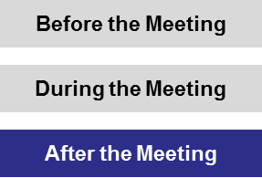
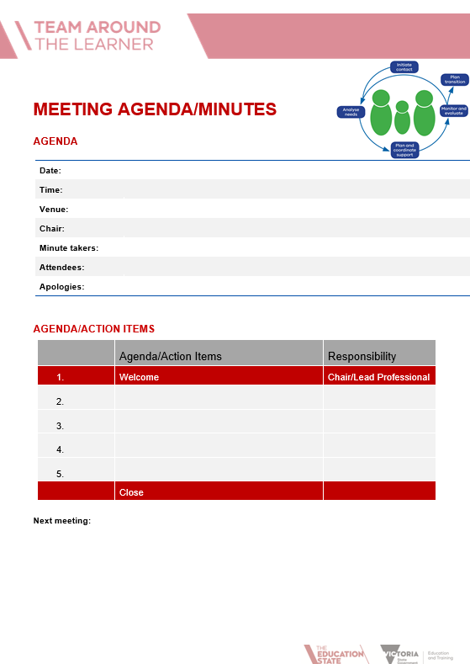
Organising meetings and facilitating effective discussion
Following the meeting the Lead Professional should formally document the agreed outcomes in the plan and distribute the minutes to the team.
The Lead Professional should ensure that all the discussions and outcomes of the meeting are captured in the minutes of the meeting and distributed to the learner, family and team in a timely manner.
Any additional meeting minutes and documentation of those responsible for particular actions should also be distributed where appropriate.
Sharing of information should be done according to the Information Sharing Consent form and DET guidelines.

Slide 27
Organising meetings and facilitating effective discussion
After the planning meeting/s are concluded and the plan is finalised the team can move to implementing it.
The plan should now be implemented with each team member undertaking the actions for which they are responsible. The Lead Professional should aid this process by:
following up with team members
informing community agencies and service providers about the Team Around the Learner process when required
identifying and obtaining necessary resources as required

Slide 28
Leading a culture of feedback and growth
Feedback is used throughout the Team Around the Learner approach as a form of communication that can encourage improvement and raise awareness in the team.
Feedback is the process of passing information from one person to another about the effectiveness of the interventions that have been put in place. It involves open communication between the Lead Professional. the learner, family and team.
It is essential that the communication is not seen as one way.
Feedback is a powerful tool that can be used to:
encourage and confirm that the team is on track
provide insight as to how the learner, family and team members are working and feeling
increase motivation and team satisfaction
increase feelings of involvement
assist with measuring outcomes of actions and strategies
help identify improvements to increase the effectiveness of strategies, actions, and teamwork.

Slide 29
Leading a culture of feedback and growth
The Lead Professional should familiarise themselves with the principles of effective feedback as outlined in Module 5 – The role of the team. It is recognised that they are critical in developing the conditions essential to creating a feedback-rich culture.
The essential elements of a feedback-rich culture include:
Safety and trust
Balance
Normalcy
Personal accountability
Advice for giving and receiving feedback is outlined in Module 5. It is critical for the Lead Professional to familiarise themselves with these skills as the behaviour modelled to the team will support a culture of feedback.

Slide 30
Identifying the need to escalate issues and asking for help
As the Lead Professional, it is important to understand when there may be a need to escalate issues that arise in team meetings.
An issue may be an important topic or action that is causing a problem, debate or frustrations within the team. Issues should be addressed early, as it is often easier to have a difficult conversation earlier rather than later.
There are a number of options available to the Lead Professional for managing issues depending on their severity:
Recognise the issue. Under no circumstances should issues be ignored. Any issue that arises during the Team Around the Learner approach should be addressed as soon as possible.
Manage the issues within the team. This involves keeping the issues within the team and working together to identify a solution. During this stage, the Lead Professional may wish to set expectations for when issues should be resolved. If the issue cannot be resolved within the team it may need to be escalated.
Escalate the issues as appropriate. In some cases, you may not be able to identify a solution within the team. This may be due to a lack of authority, effort or resources that are available. In such situations the Lead Professional should seek support from key leaders within the school or the region.
Recognise the issue
Manage the issue within the team
Escalate the issue as appropriate

