Slide 1



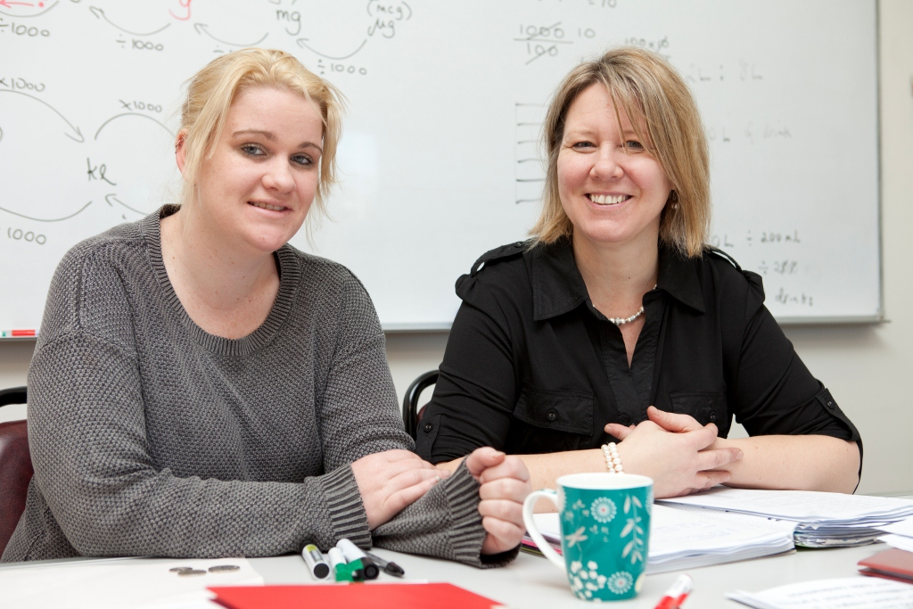
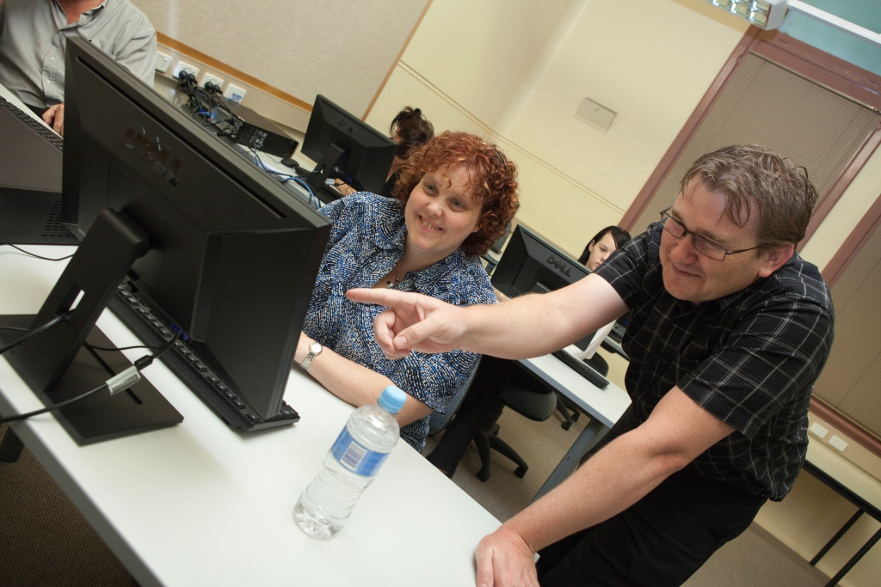

Learn Local: Focusing on the Future
Consultation

Slide 2
Contents
Context for consultation
Co-location, new partnership models, communities of practice
Mechanisms to support Learn Local organisations
Next steps
Notes:
Approximate timing of today’s session.
Opportunity to discuss slides and their content as we progress. There will be 20 minutes dedicated to the consideration of three key topics.
10.40 - ACFE Board member introduction (5 minutes)
10.45 - Slides 3-9, allowing for discussion on case studies/prompts where required (15 minutes)
11.00 - Colocation slides, 11-12 (5 minutes)
11.05 - Colocation workshop and discussion, slide 13 (20 minutes)
11.25 - Partnership slides, 15-16 (5 minutes)
11.30 - Partnership workshop and discussion, slide 17 (20 minutes)
11.50 - Communities of Practice slides, 19-20 (5 minutes)
11.55 - Communities of Practice workshop and discussion, slide 21 (20 minutes)
12.15 - Mechanisms to support Learn Local, slide 23 (10 minutes)
12.25 - Wrap up, slides 25-26 (5 minutes)
12.30 - Lunch

Slide 3
Context for consultation
Why are we here today?
Commitment to consult:
identifying and supporting opportunities for co-location;
new partnership models;
support for Learn Local organisations involvement in communities of practice.
Opportunity to help shape supports to assist Learn Local organisations
Notes:
Learn Local: Focusing on the Future contains a commitment to consult with the sector in the implementation and further development of a number of strategic directions.
SD1 involves refocusing and refining the role of Learn Local to focus on learner needs. This element of the strategy recognises that the Learn Local sector has particular strengths in supporting learners facing barriers to participation and meeting the needs of adults who choose Learn Local for training at the foundation level.
SD2 aims to promote durable networks and co-location of services to improve pathways and sustainability. This element of the strategy recognises that a defining characteristic of the Learn Local sector is its ability to establish and maintain strong connections with its local community.
SD3 involves building the Learn Local sector’s capability to deliver high quality education services. This element of the strategy recognises that keeping up to date with the best information on teaching practice, curriculum and assessment, as well as meeting administrative and regulatory requirements, can be a significant overhead for smaller organisations.
Two rounds of consultation will be held in 2014 focusing on key themes of the Strategy. Todays session will focus on the following three topics:
identifying and supporting opportunities for co-location;
new partnership models;
Support for Learn Local organisations involvement in communities of practice.
A further round will be held later in 2014. It’s focus will include:
restructuring and streamlining funding and property management arrangements to support certainty and efficiency.
integrating Learn Local into DEECD planning and resourcing processes and strategies.
improving regional governance to give a strong voice to the Learn Local sector.

Slide 4

Implementation has begun - Capacity and Innovation Fund commitment
$1 million committed in Learn Local: Focusing on the Future will support the Partnerships for Access stream.
This will open later in 2014 following outcomes from this consultation process.
Four Streams of Funding Available:
  Pathways for achievement
  Communities of Practice for Quality
  Strengthening Key Provision
  Partnerships for Access
Notes:
Implementation of the Strategy has already begun, which has included the review of the Capacity and Innovation Fund which involved consultation with the sector.
In 2013, the ACFE Board commissioned the review of the Capacity and Innovation Fund and endorsed a number of changes to the Fund in February 2014.
New streams have been developed that align with the strategic directions outlined in the Learn Local: Focusing on the Future strategy.
The Strategy also committed a further $1 million to augment the Capacity and Innovation Fund to promote partnerships. The Fund has already clearly helped establish partnerships throughout the sector. Particularly, 45 projects have been delivered through a partnership or consortium arrangements. The Partnerships for Access stream will be further informed by this consultation period and open for applications later in the year.
The redesign of the Capacity and Innovation Fund has provided an opportunity to support Learn Local organisations achieve some of the aims of Learn Local: Focusing on the Future.
Stream 1: Pathways for Achievement
Stream 2: Communities of Practice for Quality
Stream 3: Strengthening Key Provision
Stream 4: Partnerships for Access

Slide 5
Partnerships @ work in Learn Local
Prahran Community Learning Centre (PCLC) and New Hope Foundation
Grattan Gardens Community Centre
PCLC and the New Hope Foundation share the premises at 40 Grattan Street. Many groups use the Centre and an estimated 750 people attend on a weekly basis.
These include:
VCAL groups
Playgroups
Occasional Child Care
Computer classes
Yoga classes / 4 days
35 ethnic groups who meet at GGCC each week
Immigration Settlement Services
Migrant English classes
Social work / counselling / youth and adult
Notes:
Two case studies to set the scene and provide some background to aid our discussion. Further case studies are included in Learn Local: Focusing on the Future.

Slide 6
Partnerships @ work in Learn Local
Inner North Cluster (INC)
Partnership was formed to develop common objectives in cooperation and to obtain efficiencies and economies of scale that strengthen program provision and increase outcomes for the communities of the inner north of Melbourne.
6 Learn Local RTOs
Reference group of sector and non-sector stakeholders
Community service delivery focus
Shared expertise and increased efficiency
Notes:
This partnership was formed initially in 2009 with a Shared Services grant from ACFE and has since received funding from the City of Melbourne and from ACFE’s Capacity and Innovation Fund (Round 2 and 5).
Involves 6 Learn Local organisations - North Melbourne Language & Learning, The Centre Connecting Community in North & West Melbourne, Kensington Neighbourhood House, Wingate Avenue Community Centre, Carlton Neighbourhood Learning Centre, Farnham Street Neighbourhood Learning Centre.
Objectives
Improve community program service delivery to local communities of the inner North of Melbourne, and into the municipalities of Moonee Valley and Yarra
Access reciprocal expertise and assistance for all partner organisations
Improve efficiencies in compliance and quality delivery
Improve financial accountability and business viability
Improve community accountability
Share knowledge and develop skills
Investigate initiatives and opportunities for a broader provision of (program) community development
Challenges
Addressing the impact of changes in accredited training funding and regulatory requirements on small community managed organisations (RTO’s)
The challenge of focussing on issues common to partnering organisations while maintaining their independence
Small organisations committing to partnerships when day to day business operations remain a priority and organisational resources are limited
This partnership was formed in response to the changes in the training system in Victoria and the need for smaller providers to improve business operations.
(Opportunity to open discussion and reflect on peoples experience in the room)

Slide 7
Partnerships – what you’ve already told us
Opportunity to build on the collaboration and partnerships already evident within the sector to achieve further benefits.
“There are opportunities to support more Learn Local organisations interested in undertaking additional functions such as training delivery and administration through networks.”
“The Learn Local sector has developed informal and formal networks for a range of activities such as professional development, marketing and information-sharing.”
Interest in opportunities presented by new models but recognised importance of local identify and autonomy.
“Small providers of pre-accredited training were most cautious about changes to the operating model. However, they did support the ability of smaller networks to provide collegiate support and foster innovation.”
“Some providers recognised that there needs to be a change in the model but they cautioned that it would require external investment, facilitation and time to build up a level of trust and allow for the cultural shift.”
Notes:
Earlier consultations (December 2012) with the sector have informed the content and strategic directions in Learn Local: Focusing on the Future which aim to;
Increase participation and improve outcomes for low skilled and disadvantaged Victorians;
Meet demand for vocational education in some parts of the state with less provider coverage;
Ensure consistently high quality vocational education across providers; and
Improve the efficiency of cost structures, regulation, oversight and governance.
Tensions exist in pursuing new operating models and autonomy is a recognised and valued part of the sector and its identity. Change is not for everyone.

Slide 8
Partnerships – why do it?
Reduce costs
Make better use of resources
Access to specialist skills
Improve the quality and reliability of services
Reduce organisation risk
To help another organisation
Demand pressures
Sustainability pressures
Increase breadth of delivery
Are there other motivating factors your organisation experiences?
Notes:
Similar motivations exist for Learn Local providers for considering co-location, new partnership models and communities of practice
Establishment of more formal partnerships has the capacity to generate real change and deliver more cohesive and sustainable networks of providers.
Potential to share services, resource and expertise.
Deliver cost efficiencies by leveraging economies of scale.
Improve service levels that may enable to you to penetrate new markets more quickly and expand market share.
Reduce organisational risk.
Improve service quality and staff capacity.
(Opportunity to discuss- Are there other motivating factors your organisation experiences?)

Slide 9
Context for consultation
The benefits and challenges are well understood by the sector.
Opportunity to consider the possibilities available to us all and the supports required to achieve them.
Explore and discuss three elements:
identifying and supporting opportunities for co-location;
new partnership models;
support for Learn Local organisations involvement in communities of practice.
Notes:
Through the development of the Learn Local Strategy the broad directions have been set for the coming decade.
This has been developed in close consultation with the sector with over 200 Learn Local organisations participating.
Our next step is to begin to design and implement the structures and supports that will help us achieve the outcomes we all seek.
We will be workshopping 3 topics today after a brief introduction of each.
identifying and supporting opportunities for co-location;
new partnership models;
support for Learn Local organisations involvement in communities of practice.

Slide 10
Contents
Context for consultation
Co-location, new partnership models, communities of practice
Mechanisms to support Learn Local organisations
Next steps

Slide 11
‘Community Service Centres’
Expanded neighbourhood houses
Co-location will depend on the particular learning needs of communities and the availability of existing services and infrastructure.
Maternal Child Health
Education precincts
Employment services
Community hubs
Local Government
Notes:
There is a strategic need to partner.
Possible models for ‘Community Service Centres’ may include:
Expanded neighbourhood houses: Complementary education services could be included within an existing Learn Local location where the community need is for more informal educational settings and where no other infrastructure is available.
Education precincts: Learn Local vocational training services could be located with an existing educational service with good infrastructure, such as a school or early childhood centre. This form of co-location could be appropriate in communities where the local school is a strong focus of community life and activities and where there may be issues with intergenerational unemployment.
Community hubs: Facilities could be centralised and shared across a range of training, education and other social services and located in a single, integrated community facility. This may be appropriate in outer metropolitan and regional centres where there is a wide range of government and community services with dispersed and duplicated infrastructure.

Slide 12
Identifying and supporting opportunities for co-location
What are the benefits of co-location?
Profile and unified presence within a community
Improved quality of facility than could be afforded by individual organisations
Accessibility – location, but also other resources
Support opportunities enhanced through the co-location of professionals
Connections or partnerships
Resource sharing i.e. utilities, cleaning and gardening
Opportunity for rationalisation of older or less suitable facilities
Capital costs compared to stand alone facilities
Notes:
The benefits of co-location may include:
INCREASED
Increased visible profile and unified presence within a community.
Purpose built higher quality facility than could be afforded by individual organisations.
Potential to develop the facility at a more accessible location.
Access to shared spaces such as meeting space; car parking and other larger spaces may be possible.
Peer support opportunities are enhanced through the co-location of professionals.
Opportunity to establish connections or partnerships between co-located services.
Increased opportunities for resource sharing i.e. utilities, cleaning and gardening.
Opportunity to incorporate environmentally sustainable design principles into the building of new facilities thus reducing the environmental impact of users and providing practical examples for the community.
Opportunity for property rationalisation of older or less suitable facilities.
DECREASED
Lower capital costs than creating and managing stand alone facilities.

Slide 13
Workshop questions - Identifying and supporting opportunities for co-location
What do you understand of the concept of co-location and the opportunities it presents?
What are the challenges you are experiencing in pursing these opportunities?
What support do you need from DEECD and the ACFE Board in pursuing these opportunities and addressing the challenges?
Notes:
3 questions to work through in groups (or individually as numbers dictate). Please choose a scribe as appropriate to capture the groups input for consolidation following the session.
1. What do you understand of the concept of co-location and the opportunities it presents?
2. What are the challenges you are experiencing in pursing these opportunities?
3. What support do you need from DEECD and the ACFE Board in pursuing these opportunities and addressing the challenges?
Spend 5 minutes on each and then a further 5 minutes for a whole of group discussion to share views.

Slide 14
Contents
Context for consultation
Co-location, new partnership models, communities of practice
Mechanisms to support Learn Local organisations
Next steps

Slide 15
Partnership models
Cooperation
Alliance
Merger
Models for Collaboration
Purchasing consortium
Incorporation with existing entity
Shared training delivery
Shared corporate services
Joint venture
Shared facility
Formal strategic alliance
Federation
Notes:
Partnerships models can sit on a spectrum from informal cooperation through to formal mergers which are included for illustrative purposes. These activities are more substantial than an informal partnerships.
Purchasing consortium – For example a group of ten providers decide to join together to procure new computers for their respective classrooms which makes their business more attractive to the supplier and results in a reduction in the supplier’s cost.
Shared Training Delivery - Providers in collaboration develop and deliver training in partnership. This may provide improved access to training for their students (particularly in regional areas). It may also encourage the sharing of specialist academic expertise in specific areas of the training
Shared corporate services - Two or more organisations working together to manage or deliver non-client services. Back-of-house services include any service that does not directly support clients, for example, human resources, finance, payroll, marketing procurement and legal advice.
Joint venture - Created by agreement between two or more organisations wanting to undertake a project together where, at the end of the project, both will share in the output. Benefit from complementary expertise but common aims.
Shared facility - An agreement between parties to share the use of an existing or planned facility. This could include License agreements that apply when a provider used another organisation’s facility on a regular basis. For example - Provider A enters into a licence agreement with the local Neighbourhood House to use its kitchen facilities to deliver hospitality courses.
Formal strategic alliance - A Strategic Alliance is a relationship between two or more provider to pursue a set of agreed upon goals or to meet a critical business need while remaining independent organizations. Strategic alliances can take on many forms such as: technology transfer, purchasing and distribution agreements, marketing and promotional collaboration and joint product development
Federation – A federation is an organisation or group within which smaller divisions have some degree of internal autonomy. For example - Provider A and Provider B decide to operate under an umbrella name but retain their respective Boards of Management and introduce a combined Committee to oversee joint operations including strategy and marketing.

Slide 16
Partnership models
What are the benefits of new partnership models?
Improved access to training for students
Sharing of specialist academic expertise in specific areas of training
Quality of back of house services - less time working on administrative tasks
Opportunity for greater market reach and greater opportunities for growth
Opportunities to expand course offerings
Reduced duplication resulting maximum use of facilities and services
Reduced costs by the pooling of expertise and resources
Notes:
Partnerships are already widespread in the ACE sector, delivering considerable benefits, and there is scope for further promotion.
Successful partnerships exhibit a number of characteristics, including:
Strong cooperative relationships between partners
Entrepreneurial local leadership and a willingness to make things happen
A clear understanding among all partners of how the relationship will be managed
The benefits of new partnership models may include:
improved access to training for their students (particularly in regional areas)
Reductions in costs which can promote higher levels of quality, improved service and the ability to allocate more resources to investment services that support learners
encourage the sharing of specialist academic expertise in specific areas of training
Reduced cost of back-of-house services by leveraging economies of scale or gaining access to better systems/processes than are available by working alone
Improved quality of back of house services so that staff spend less time working on administrative tasks
Opportunity for greater market reach and greater opportunities for growth
Opportunities to expand course offerings
Less duplication/maximum use of facilities and services
Shared training delivery can reduce costs by the pooling of expertise and resources

Slide 17
Partnership models
What do you understand of the concept of new partnership models and the opportunities they present?
What are the challenges you are experiencing in pursing these opportunities?
What support do you need from DEECD and the ACFE Board in pursuing these opportunities and addressing these challenges?
Notes:
3 questions to work through in groups (or individually as numbers dictate). Please choose a scribe as appropriate to capture to groups input for consolidation following the session.
1. What do you understand of the concept of new partnership models and the opportunities they present?
2. What are the challenges you are experiencing in pursing these opportunities?
3. What support do you need from DEECD and the ACFE Board in pursuing these opportunities and addressing these challenges?
Spend 5 minutes on each and then a further 5 minutes for a whole of group discussion to share views.

Slide 18
Contents
Context for consultation
Co-location, new partnership models, communities of practice
Mechanisms to support Learn Local organisations
Next steps

Slide 19
Support for Learn Local organisations involvement in communities of practice
Communities of Practice
Common interests
One organisation or many
Long term benefits
Often informal
Professional skills
Good practice
What are communities of practice?
Notes:
Communities of practice can be multi faceted much like other forms of partnership.
Communities of practice are groups of staff bound together by common interests and a passion for a cause, and who continually interact. Communities are sometimes formed within the one organisation, and sometimes across many organisations.
They are often informal, with fluctuating membership and people can belong to more than one community at a time.
Are different from formal work groups, project teams or informal networks, in emphasising the development of members’ capabilities and the building and exchange of knowledge.
Additionally, communities of practice can change their agenda to suit the needs of the members; assist with the development of professional skills; assist in the transfer of good practice; and have long-term benefits on organisational practice and productivity.

Slide 20
Support for Learn Local organisations involvement in communities of practice
Encourage sharing information and building collaborative practices
Enabling employees to manage change, access to new knowledge and fostering a sense of common purpose amongst staff.
Informal dissemination of valuable information, improvements in productivity and the fostering of innovation.
Improved quality of programs, services and pathways for learners
Reduction in costs of program development and compliance
Improvement and innovation in training curricula, pedagogy and assessment that deliver high-quality training
Notes:
To support continuous improvement in teaching and learning practice in the sector, the government and the ACFE Board will encourage Learn Local organisations to share information and build collaborative practices in relation to pre-accredited training delivery
Benefits
Benefits for individual organisations could include: enabling employees to manage change, access to new knowledge and fostering a sense of common purpose amongst staff.
The organisational and network benefits of communities of practice would include: the informal dissemination of valuable information, improvements in productivity and the fostering of innovation.
Improved quality of programs, services and pathways for learners
Reduction in costs of program development and compliance.
A focus on improvement and innovation in training curricula, pedagogy and assessment that aligns with the government’s objective for the broader training sector to deliver high-quality training

Slide 21
Support for Learn Local organisations involvement in communities of practice
What do you understand of the concept of communities of practice and the opportunities they present?
What are the challenges you are experiencing in pursing these opportunities?
What support do you need from DEECD and the ACFE Board in pursuing these opportunities and addressing the challenges?
Notes:
3 questions to work through in groups (or individually as suitable). Please choose a scribe as appropriate to capture to groups input for consolidation following the session.
1. What do you understand of the concept of communities of practice and the opportunities they present?
2. What are the challenges you are experiencing in pursing these opportunities?
3. What support do you need from DEECD and the ACFE Board in pursuing these opportunities and addressing the challenges?
Spend 5 minutes on each and then a further 5 minutes for a whole of group discussion to share views.

Slide 22
Contents
Context for consultation
Co-location, new partnership models, communities of practice
Mechanisms to support Learn Local organisations
Wrap up

Slide 23
Mechanisms to support Learn Local organisations
Clearer guidelines
Cross-sectoral community of practice networks
Longer activity schedules
How can DEED and the ACFE Board best support Learn Local organisations in achieving strategic outcomes?
Multiple-year funding contracts
Capacity and Innovation Grant Program
Notes:
There are a range of supports committed to in Learn Local: Focusing on the Future which your feedback today will assist in developing.
Proposed DEECD and ACFE Board Support
clearer guidelines to support co-location and improved use of Victorian Government owned properties.
longer activity schedules - as part of the funding contracts for pre-accredited training to individual or networks of Learn Local organisations that can deliver training above a specified delivery level. This could include consideration of multiple-year funding contracts for pre-accredited training to Learn Local organisations that enter into durable and consolidated structural arrangements for the delivery of accredited and pre-accredited training.
multiple-year funding contracts – potentially to Learn Local organisations that enter into durable and consolidated structural arrangements for the delivery of accredited and pre-accredited training.
applying greater consideration of scale, sustainability and Learn Local organisational networks and partnership durability to inform the operation of the Capacity and Innovation Grant Program.
DEECD Regional offices to facilitate engagement of Learn Local organisations in cross-sectoral Community of Practice networks.

Slide 24
Contents
Context for consultation
Co-location, new partnership models, communities of practice
Mechanisms to support Learn Local organisations
Next steps

Slide 25

Wrap up
All partnerships require development and commitment over a sustained period
Take action
Embed and sustain the change
Create buy-in
Use leverage and engagement at scale to build critical mass
Deepen understanding
Equip and activate leaders to drive change
Make it stick
Involvement and ownership
Build awareness
Define where we are going and why
Build and mobilise
Engage for action
Set direction
Elapsed time
Notes:
All partnerships require development and commitment over a sustained period to ensure success and achievement of outcomes.
Vertical axis: Represents the level of involvement and ownership from low to high
Horizontal axis: Represents elapsed time from low to high
Lowest point on x and y axis. Set direction stage. Need to build awareness, define where we are going and why.
Higher on x and y axis. Engage for action stage. Need to deepen understanding, equip and activate leaders to drive change.
Higher on x and y axis. Build and mobilise stage. Need to create buy-in, use leverage and engagement at scale to build critical mass.
Highest on x and y axis. Make it stick. Need to take action, embed and sustain the change.
‘Buy in’ from partner organisations is essential to creating lasting benefits – this is not an easy process.

Slide 26
Next steps
“The sector needs greater support in forming partnerships, alliances and networks, and integrating more effectively with other training providers and community organisations. This would provide a complete service for learners and result in programs being accessed by a greater number of people.”
A further opportunity for Learn Locals to provide input through the survey circulated via Participation Branch memorandum also available at: http://www.education.vic.gov.au/training/providers/learnlocal/Pages/memo.aspx
Tell us more by responding to: access.equity@edumail.vic.gov.au by Friday 4th April 2014.
Contributions will help shape the Partnerships for Access stream of the CAIF and further implementation of commitments in Learn Local: Focusing on the Future.
Notes:
Recap outcomes from todays discussion:
Co-location.
Partnership models.
Communities of practice.
A further opportunity for Learn Locals to provide input through the survey circulated to the sector in Participation Branch memorandum.
Tell us more: access.equity@edumail.vic.gov.au by Friday 4th April 2014.
Discussion and contributions to the survey will help shape the Partnerships for Access stream of the CAIF and further implementation of commitments in Learn Local: Focusing on the Future.
Thank participants.

