Slide 1
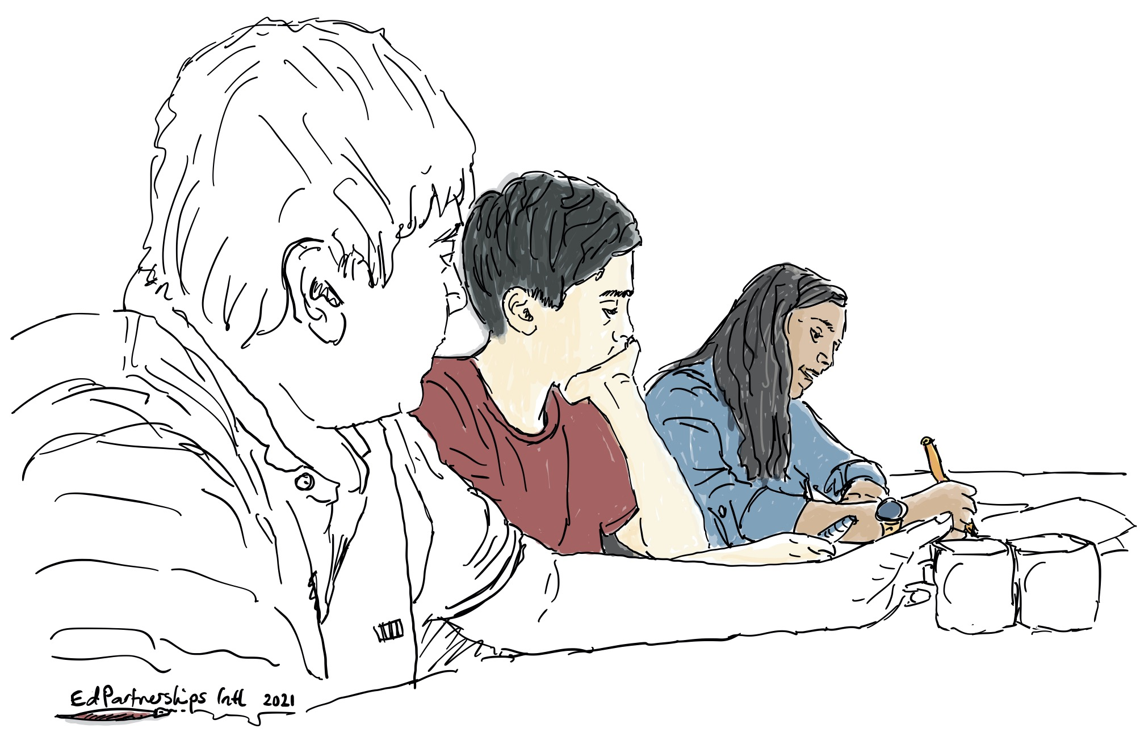
Learning Focus Area 4
4.1 Meaningful Reporting Re-Imagined Booklet
Making sense of our learning and preparing to take action
Investigation Booklet

Slide 2
LFA 4.1 Contents
LFA 4: 4.1 Meaningful Reporting Re-Imagined Booklet
Contents of this Booklet
An overview of the Process………………………………………………………………………………………….……..………..…page 3
Meaningful Reporting Workshop – Part A: Sharing, Discussing and Analysing………………………..….…pages 4-5
Meaningful Reporting Workshop – Part B: Planning for Action ……………………………...........................pages 6-7
Meaningful Reporting Workshop – Part C: Ideas and Implications for Re-Imagining our Student Reporting and Reports ……….…………………………………………………………………………………………………………………………...page 8
Re-Imagining Workshop – Part A: Considering Reporting Principles & Forms of Reporting………….pages 9-11
Re-Imagining Workshop – Part B: Planning for Action…………………………………………..……………….… pages 12-13
Re-imagining Workshop – Part C: Drafting a Re-Imagined Reporting Process and Reports…………pages 14-15

Slide 3
Preparation for Workshops
Meaningful Reporting Re-Imagined: Preparation
Overview:
Learning Focus Area 4 weaves what has been learned previously into action. School leadership teams, in partnership with the learning community focus group, take a ‘deeper dive’ into the findings from the three previous Learning Focus Areas.
The aim of Learning Focus Area 4 is to engage the broader community with the aspirations and findings that have emerged and to develop specific actions that enable more meaningful student reporting.
Following this, the learning community works together to re-imagine student reporting and reports.
Preparation:
To begin, the leadership team familiarise themselves with this booklet and schedule workshops to undertake Parts A, B and C of the Meaningful Reporting Workshop.
Once this is completed, they meet to schedule Parts A, B and C of the Re-imagining Workshop.

Slide 4
Meaningful Reporting – Part A
Meaningful Reporting - PART A: Sharing, Discussing and Analysing
The leadership team follows these steps:
Establish mixed groups that have:
one member from the leadership team
one student, one teacher, and one parent or carer from the learning community focus group.
Provide each group member with a copy of the investigation findings from LFA1, LFA2 and LFA3.
Allow 10-15 minutes for group members to read the findings from LFA 1. Have them note any findings they would like to discuss in more detail. Have the leadership team member record responses on their copy of LFA1 evidence.
Allow 10-15 mins for the leadership team member to share the investigation findings from LFA 2 and LFA 3.
Invite other group members to ask questions for further consideration. The purpose is for everyone to have a deeper understanding of what has been revealed and learned along the way.
Bring the groups together and complete the SUN analysis scaffold on page 5. You might like to enlarge page 5 to A3 size for ease of recording and sharing.

Slide 5
Meaningful Reporting – Part A
What identified strengths exist in our current assessment reporting processes?
Why is this significant?
What uncertainties have emerged from our investigations? (frame these as questions…questions for further investigation –this part leads into the needs).
What do we need to further investigate or consider to more deeply understand these uncertainties?
(What could it mean if we don’t ?)

Slide 6
Meaningful Reporting – Part B
Meaningful Reporting – PART B: Planning for Action
The leadership team follows these steps:
Remain as a single group.
Refer to the needs identified in the SUN Analysis.
Use the SUN Actions Scaffold on page 7.
Determine actions that address the needs you’ve discovered.
Build out the actions by describing:
who will be involved
when they will occur.

Slide 7
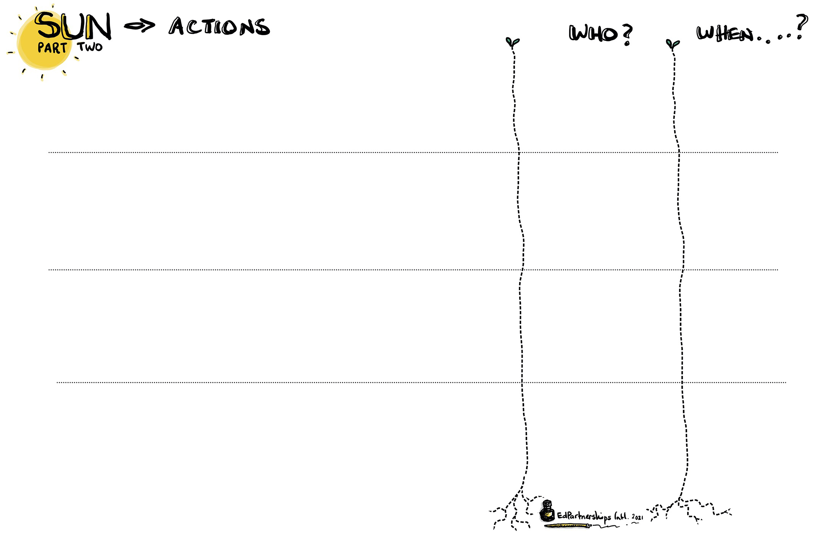
Meaningful Reporting – Part B

Slide 8
Meaningful Reporting – Part C
Meaningful reporting - PART C: What has emerged in light of our SUN actions?
Recap findings from the SUN Analysis and Action Scaffold with the learning community focus group.
A member of the leadership documents findings and implications below.
What has been revealed?
Implications for the re-imagining of our student reporting process?

Slide 9
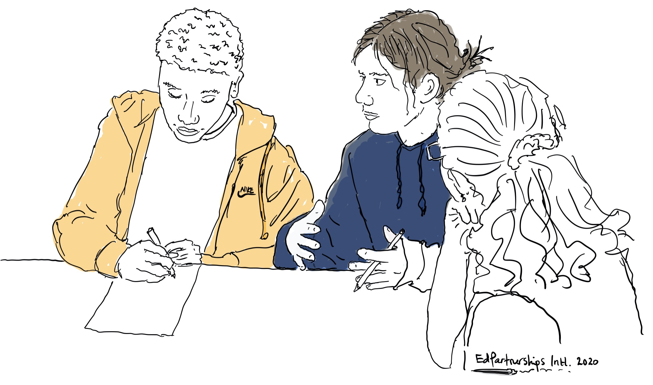
Re-Imagining – Part A
Reimagining - PART A: Considering Reporting Principles and Forms of Reporting
The leadership team follows these steps:
Establish mixed groups that have:
one member from the leadership team
one student, one teacher, and one parent or carer from the learning community focus group.
Distribute copies of these to participants:
Analysis Lens 1 - Reporting Principles
Analysis Lens 2 - Forms of Reporting
4. Refer to ‘Connect-Extend-Challenge’ located in the Professional Reading Discussions Guide booklet (pages 2-3). Invite participants to read the documents. As they read, have them identify:
CONNECTIONS that resonate with past experiences or current thinking. Mark with a ✓
NEW IDEAS that extend thinking further. Mark with an !
CHALLENGES to act upon in the article, or ideas that are challenging. Mark with a ?
5. Use the ‘Connect-Extend-Challenge’ conversation process prompts to discuss the connections, ideas and challenges group members found.
6. Come back together as a whole group, sharing key take aways.

Slide 10
Re-Imagining – Part A
Reimagining - PART A (continued): Considering Reporting Principles and Forms of Reporting
The leadership team follows these steps:
Distribute the Reporting Principles document.
Have each group read Reporting Principles
Use the scaffold on page 5. Identify the reporting principles that:
are strengths in the current reporting process
need strengthening in the current reporting process.
Distribute the Forms of Reporting document.
Have each group read Forms of Reporting.
Use the scaffold on page 5 to identify the forms of reporting that:
are strengths in the current reporting process
need strengthening in the current reporting process.

Slide 11
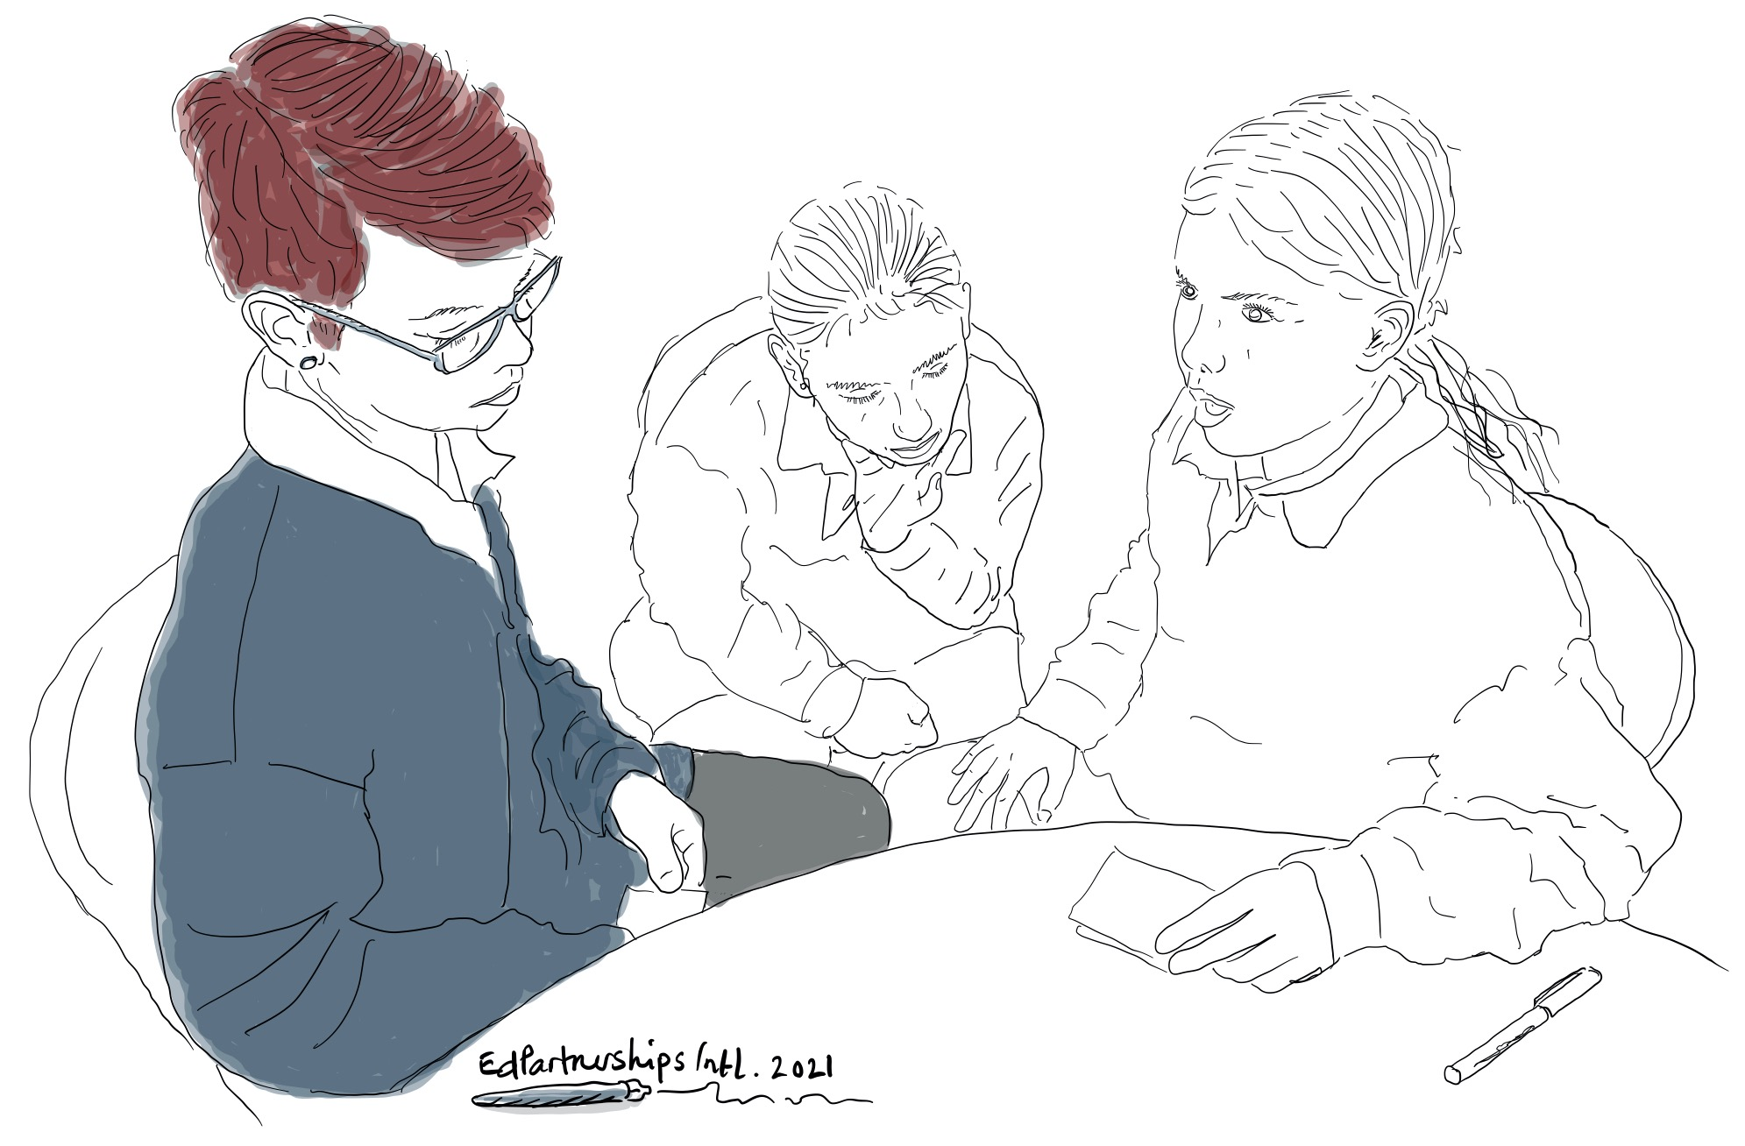
Re-Imagining - Part A
Reimagining - PART A (continued): Considering Reporting Principles and Forms of Reporting
7. Come together as a whole group
8. Have one representative from each groups share their findings.
9. Have a member of the leadership team record responses on an A3 copy of the scaffold (page 5).

Slide 12
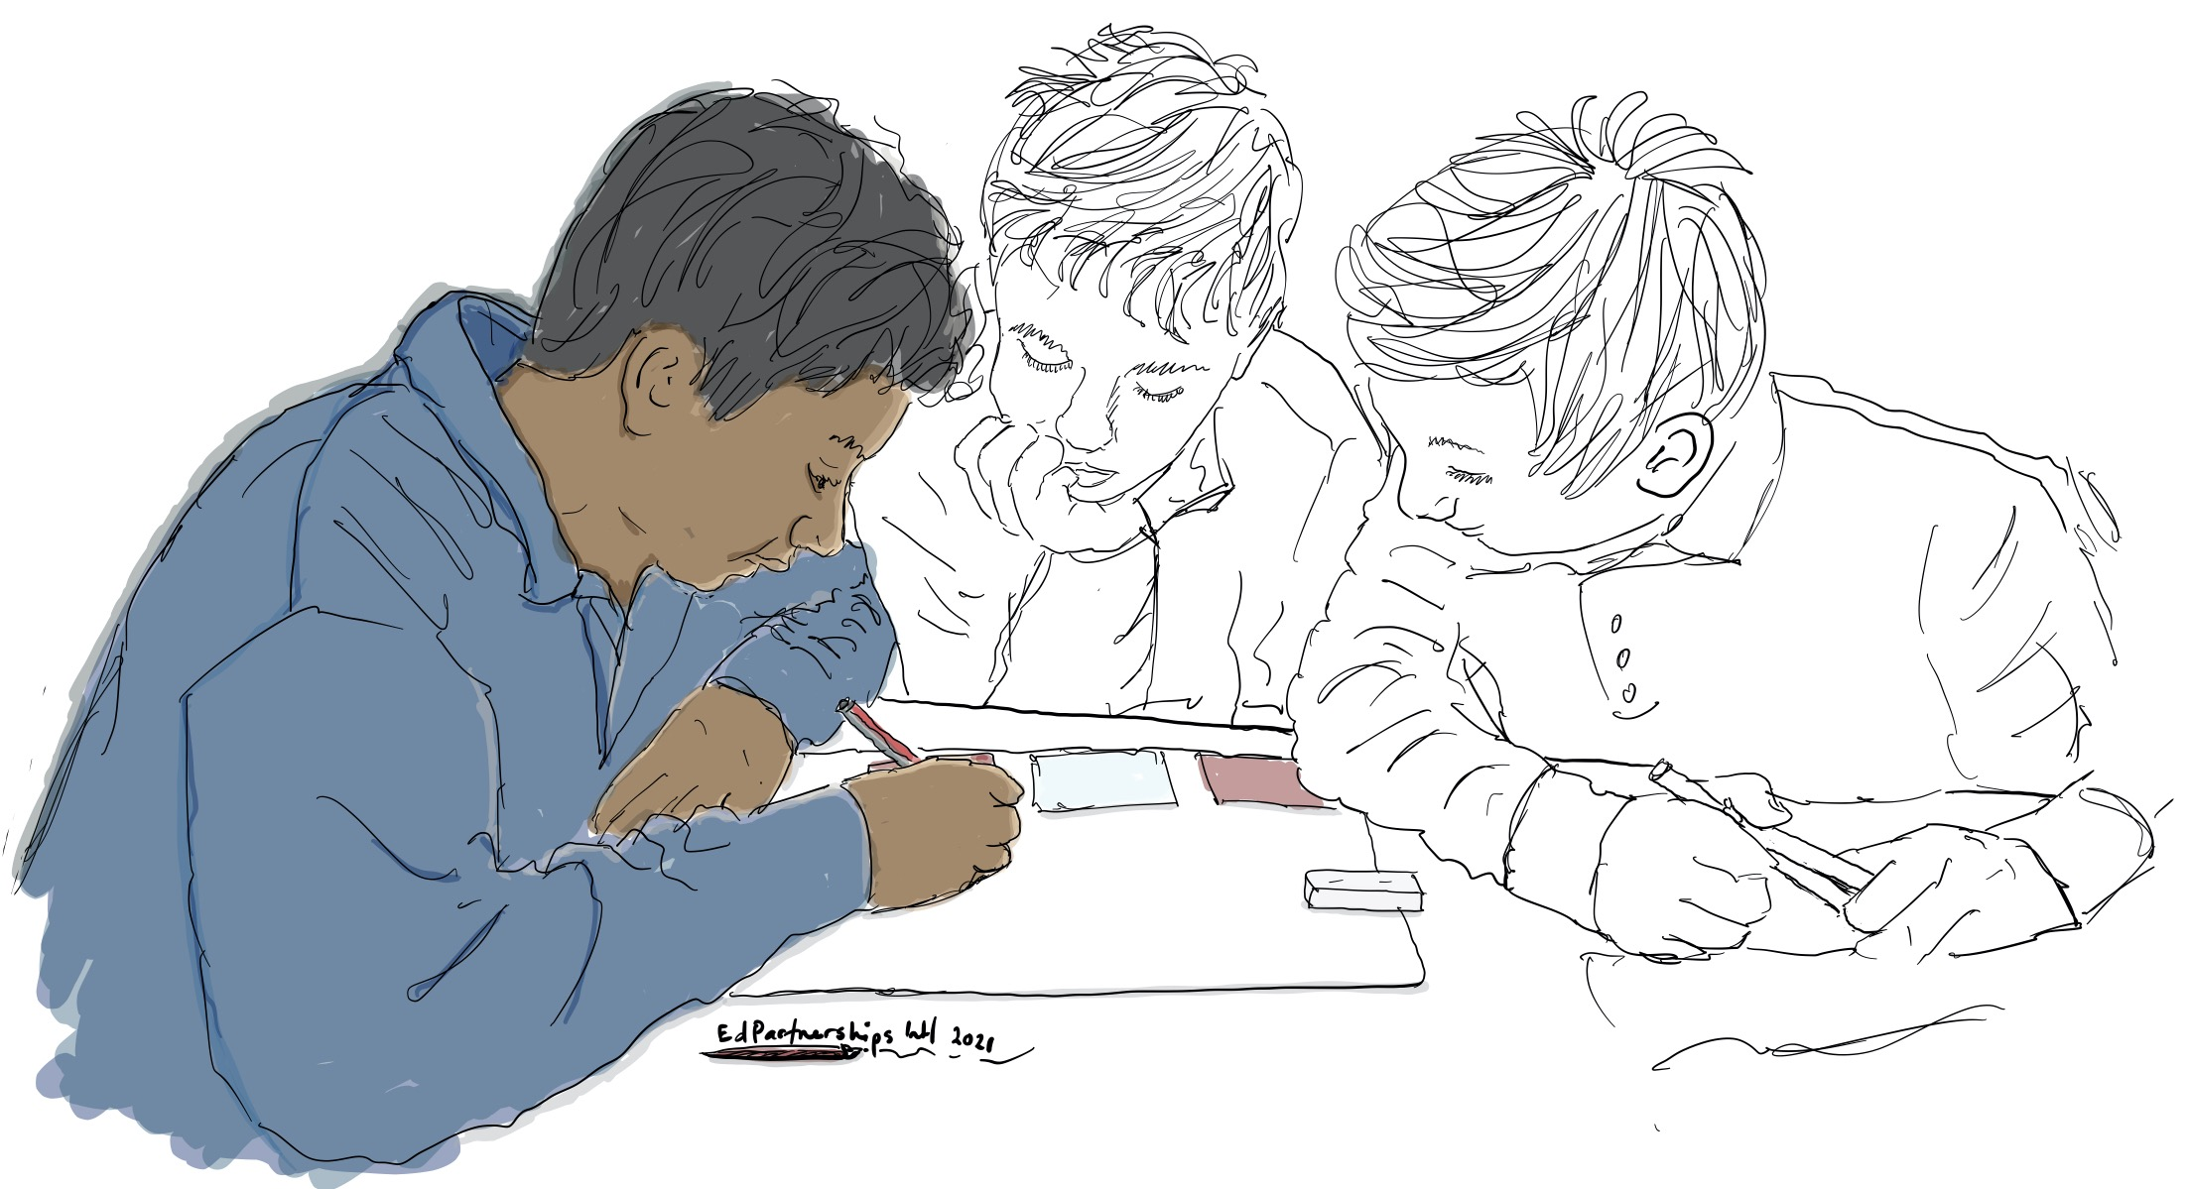
Re-Imagining – Part B
Re-Imagining – PART B: Planning for Action
The leadership team follows these steps:
1. Download and read:
the DET Reporting Student Achievement and Progress policy- Summary section
Guidance on Reporting to parents and carers - general information.
Student Report Format
Quick Tips for writing reports
Student report writing checklist
Summarise the relevant requirements expected of the school.
Schedule a sharing meeting with the learning community focus group.

Slide 13
Re-Imagining – Part B
Re-Imagining – PART B (continued): Planning for Action
The leadership team follows these steps:
Share the summarised requirements expected of the school with the learning community focus group.
Discuss how the school could address these requirements in a way that is more meaningful to families.
Document these ideas.

Slide 14
Re-Imagining - Part C
Re-Imagining - PART C: Drafting a Re-imagined Reporting Process and Reports
The leadership team follows these steps:
Hold a meeting with the school leadership team, learning community focus group and investigation team.
Refer to:
The SUN analysis from ‘Meaningful reporting - PART A: Sharing, Discussing and Analysing’
The SUN actions from ‘Meaningful reporting - PART B: Planning for Action’
The group responses from ‘Re-imagining - PART A: Considering Reporting Principles and Forms of Reporting’
The ideas documented on how the school could address reporting requirements from ‘Re-Imagining– Part B: Planning for Action’.
Draw on the Parts A, B and C of the Meaningful Reporting Workshop and Parts A and B of the Reimagining Workshop. The learning community focus group and members of Investigation Teams are guided by the leadership team to begin drafting a reimagined reporting process.
Members of the leadership team then organise meeting/s to share what has been collectively learned with the wider school community, making sure that members of the focus group are able to be present and lead small group discussions. This re-imagined reporting document will then be taken to the broader school community for further discussion and refinement.

Slide 15
Re-Imagining – Part C
Re-Imagining - PART C (continued): Drafting a Re-imagined Reporting Process and Reports
8. Draft a reimagined reporting process.
9. Share reimagined reporting process with the wider school community.
10. Ensure members of the investigation team and learning community focus group are present and lead small group discussions.
11. Make further refinements based on the discussion.

