Slide 1
Implementing the Team Around the Learner approach
Module 9
Plan and Coordinate Support

Slide 2
Module 9: Plan and Coordinate Support
Overview
The aim of this module is to provide the team with the required skills to develop and implement an individualised plan for a learner. The module will follow the phases from needs identification through to goals and strategy development and assignment of roles and responsibilities. The final part of this module looks at the role of the Lead Professional in supporting the learner, family and team through implementation of the plan.
Focus
This module will support your ability to:
9 Plan and Coordinate Support
An overview of the Plan & Coordinate Support phase
Developing the plan
Create a shared vision
Understanding and prioritising the needs of the learner
Developing goals and key success indicators
Collaboratively develop strategies
Actions to achieve strategies
Supporting the team through implementation

Slide 3
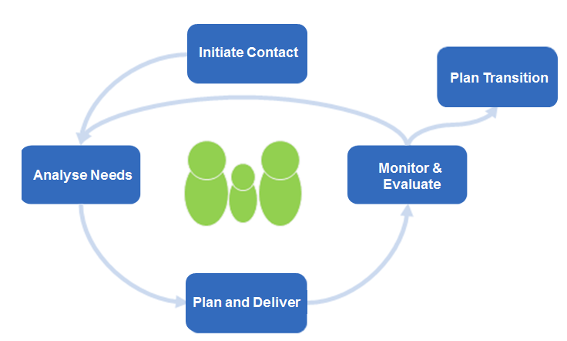
An overview of the Plan and Coordinate Support phase
Plan & Coordinate
The aim of the Plan and Coordinate Support phase is to develop an individualised plan that will improve outcomes for the learner.
This module will look at:
how the team considers the information gathered in the extensive Analyse Needs phase
the long term goals or vision of the learner and how this is shared with others
the smaller achievable steps (short term goals) that can be planned
the most appropriate and feasible strategies that will assist the learner to achieve the goals
what success would look and feel like for the learner as goals are achieved
who will assist the learner at each stage to achieve the goals
how the team will coordinate support

Slide 4
Developing the plan
The plan starts with the development of a vision of what the learner and family want to achieve.
The team needs to understand the learner's current needs and set long term and short term goals to improve outcomes for the learner.
The plan involves:
Setting a vision (long term goals) for the learner and family
Understanding and prioritising the needs of the learner
Developing short term goals and key success indicators with the team
Collaboratively developing strategies and allocating roles and responsibilities
Plan & Coordinate
Vision
Goals
What do we want the future to look like?
Strategies
What do we want to achieve?
Actions
How will we achieve it?
Who will do what?

Slide 5
Developing the Individual Education Plan
An effective plan clearly outlines the goals, timelines and supports for the learner; and allows for feedback at the end of each stage.
The Individual Education Plan should be a cumulative document that clearly shows:
the learner’s goals at the beginning of each stage
the feedback from the team on the effectiveness of the strategies and actions
Plans put in place in isolation from the learner will generally alienate the learner from the process. They will feel being ‘done to’ and will not feel connected to the plan.
To make this an enabling process, the learner needs to be involved throughout. This involvement, of course, will be adjusted to suit the age and capabilities of the learner. He/she will provide information related to their needs and wants, and this will encourage their commitment to the vision, goals, strategies and actions.
The team should agree to when a review meeting will take place. Feedback from the learner and team will form part of the Monitor & Evaluate phase of the Team Around the Learner approach.
Resources
Individual Education Plan

Slide 6
Creating a shared vision – long term goals
Vision
Goals
Strategies
Actions
The team should create some long term goals with the learner that clearly outline a shared vision for the future.
The following outlines a process for facilitating a discussion on the development of the vision:
the learner and family should be given the opportunity to present their views on what they think the vision should look like
refer to the comprehensive Analyse Needs phase
the team should collaboratively add their input
the learner should agree on what the vision will be
the vision should be clear and simple and summarised into 1-2 sentences
the Lead Professional should capture the vision in the plan
to understand how to get the learner and family to where they want to be, their current needs should be identified.
This should guide the development of the goals, strategies and actions for the learner.
Example Vision for Brody Smith
To be engaged in school until Year 12 and enjoy learning with friends
Notes:
The Lead Professional should present the findings from the strengths document in the Initiate Contact phase to the team. Feedback should be sought from the team and any additional strengths added. The discussion should then be steered towards setting the culture of the team moving forward and identifying the vision for the learner for the future. The idea of a vision and what it could look like should be introduced and the learner and family given the opportunity to present their views.
The vision for the future should be summarised into one to two sentences and captured in the learner’s Plan.

Slide 7
Developing goals and key success indicators Short term goals are developed with the learner, family and team to achieve the vision. Together with the learner and family, the team should develop a number of goals that when achieved will be successful in meeting the prioritised needs of the learner. This activity should be facilitated by the Lead Professional. Using a SMART approach to goal development
Vision
Goals
Strategies
Actions
Specific | Measurable | Agreed | Relevant | Timebound
What is it exactly that you want to achieve? | How will you know when you have accomplished the goal? | Does the team, including student and family, agree on this goal? | Is this goal relevant to the needs of the learner? | When will this goal be accomplished? How often will it be reviewed?
The goal should be clear and concise where possible | The goal must be written in a way that can be measured – concrete and observable | Specify what involvement the student had in the process of developing the agreed goals. | The goal should bear in mind any factors that may impact on your ability to reach the goal | Having a specific time frame provides motivation to get started
Example of a SMART goal Brody will attend three maths classes and one tutoring session per week during term three. The frequency of Brody’s attendance will be measured by maths class attendance data and completion of set tasks. This will be monitored by the Lead Professional in conjunction with his teachers and family.

Slide 8
Developing goals and key success indicators
Vision
Goals
Strategies
Actions
Establishing key success indicators is a vital component of the goal setting phase.
Key success indicators are a set of criterion that outline what success would look like when the goal is achieved.
The indicators should be:
developed by the team
derived from the SMART goal development
measurable
reviewed frequently
These indicators are linked to the Monitor & Evaluate phase and will be captured within the plan.
Depending on the need being considered, there may be multiple goals defined by the team and subsequently multiple indicators developed to be measured and tracked. Although, there is no limit on the number of needs, goals and indicators, the number should not overwhelm the learner and should be considered by all as achievable.
Brody’s goal
To attend three maths classes and one tutoring class per week during term three.
Success indicators
Attend one/two tutoring sessions per week with Ms Jones.
Commence attending a maths class, and build up to attending three classes per week. Complete set tasks.
Attendance and engagement in each class will be recorded and available for learner and family to view
Notes:
Critical factors about goals:
They should be agreed to beforehand
They should reflect the indicators of success in their design
Their measurement needs to be determined and agreed to
How frequently they will be measured and reviewed should be determined
Their measurement should inform the success of each goals
How they link to the monitor and evaluate phase
They should be captured in the Individual Learning Plan

Slide 9
Collaboratively develop strategies Strategies and actions should be developed to support the achievement of each goal.
Vision
Goals
Strategies
Actions
The Lead Professional should guide an open and collaborative conversation to develop strategies and actions for each goal .
Strategies should incorporate the strengths of the learner and family and be consistent with their culture and values. The actions should be agreed upon as a team and focus on person centred, family sensitive practice. The confirmed actions and strategies should be documented in the plan.
In developing the strategies for each goal the following steps should be considered
Brainstorm different strategies for achieving each goal
Discuss previous strategies – what has worked in the past?
Choose the strategies that will be used to support the achievement of the goals
Notes:
Discuss actions and strategies that have been successful in the past
A powerful way of increasing the likelihood of success of the Individual Learning Plan is to discuss the actions and strategies that have worked well in the past and learn from the ones that have not. This should be an open discussion facilitated by the Lead Professional, where blame should not be placed on why things might not have worked well, but instead on how they can be improved for next time.
The learner and family should be afforded the opportunity to discuss what works well for them and why. Providing insights into the reasons strategies were unsuccessful in the past from their perspective can make planning for the implementation of similar strategies smarter and more effective for them.

Slide 10
Actions to achieve the strategies
Vision
Goals
Strategies
Actions
Specific actions for achieving the strategies should be developed and documented.
Responsibility for undertaking each of the strategies should be assigned to the appropriate individual at the meeting
For each strategy a number of specific actions should be outlined. The Lead Professional should facilitate a team discussion on the development of the actions for each strategy:
actions should be specific to ensure that they are completed and that team members can be held accountable
actions should be agreed as a team and should focus on the strengths of the learner and consider a person centred, family sensitive approach.
the learner and family should be consulted throughout the process and agree on the actions
These might be as simple as assigning who needs to make a phone call, to whom and by when. The following should be considered when assigning responsibilities:
what is the learner’s commitment at this stage?
is the team member the right person for completing the action/s?
does the team member have the right capability for completing the action/s?
not all team members will have equal amounts of responsibility to undertake. However, the Lead Professional should ensure that team members are not overburdened with the number of responsibilities they are assigned.
Actions, roles and responsibilities should be clearly defined and documented in the plan
Notes:
Develop specific actions for achieving the strategies
Assigning roles and responsibilities to team members to achieve the actions and strategies

Slide 11
Supporting the team through implementation The plan should be reviewed by the team once all goals, key success indicators, strategies and actions have been documented and roles and responsibilities allocated.
Vision
Goals
Strategies
Actions
The Lead Professional should seek confirmation from the learner, family and team that they agree to the actions and are clear on the next steps. Any issues identified should be raised and discussed at this time.
Final approval for the plan must come from the learner and family at the meeting. The Lead Professional should ensure that all the information covered in the discussions is captured in the plan and each team member receives a copy.
Support the learner, family and team members to ensure strategies are implemented.
The Lead Professional supports the family and team members to implement the plan by checking in and following up with them, providing them with advice and support where needed.
Throughout the implementation process, the Lead Professional will act as the point of contact for both the learner and team and provide advice, guidance and assistance where necessary.
Any issues that occur during the implementation of the plan should be communicated so that appropriate measures can be taken. This may involve reconvening the team and revising the plan.
The Lead Professional should establish formal and informal channels of communication with the team.

