Slide 1

Implementing the Team Around the Learner approach
Module 8
Analyse Needs

Slide 2
Module 8: Analyse Needs
Overview
The aim of this module is to guide the team in ways to gather, share, analyse and use a wide range of data and information so that an effective plan for the learner can be developed. The module will look at how the context of both the learner and the school need to be considered.
Focus
This module will support your ability to:
8 Analyse Needs
An overview of the Analyse Needs phase
Gathering relevant data and information
Organise referrals and assessments
Sharing information
Understanding the learners context
Accommodate the needs of the learner within the school context
Actions to achieve strategies
Supporting the team through implementation

Slide 3
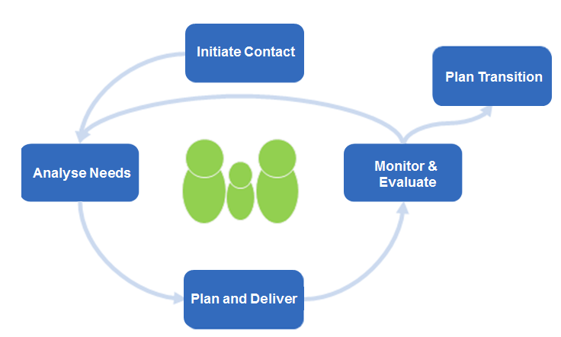
An overview of the Analyse Needs phase
Initiate Contact
Plan Transition
The Analyse Needs phase builds on the information gathered through the Initiate Contact phase and will further inform the Plan & Coordinate Support phase.
The goal of the Analyse Needs phase is to understand the underlying and presenting issues of the learner.
Analyse Needs
Monitor & Evaluate
Plan & Coordinate
The information gathered in the Initiate Contact phase should be used to develop a comprehensive and holistic understanding of the learner’s needs.
a comprehensive understanding and needs analysis is particularly important as most of the learners taking part in the Team Around the Learner approach will have additional and/or complex needs.
additional information and assessments may be requested to gain a full understanding of the learner’s strengths and challenges.
open and frank sharing of information is vital so that the following phases can be relevant and effective.
analysing the needs of the learner will lead to some decisions about what is realistic, achievable and feasible.
the learner and family are fully involved in this phase and are supported by the Lead Professional.
The activities of this phase should be as thorough as possible and will inform the urgency and type of assistance required
analysing the learner’s needs is a continuous process in which information is continuously collected to understand the impacts on the learner, so that a meaningful plan can be put in place.
the needs of the learner continue to change and develop. Therefore the analysis of needs requires ongoing discussion to enhance the learner’s plan for future growth.
Notes:
This phase may be initially conducted as a broad conversation with the learner and family to identify the needs that they view as important
Through these discussions, it may be identified that there is a need for referral to additional services so that more detailed information can be gathered.
Other people may be identified to be part of the team and should be contacted and briefed with the permission of the learner and family.
Looking at all the information collected, the team conducts a comprehensive needs analysis.

Slide 4
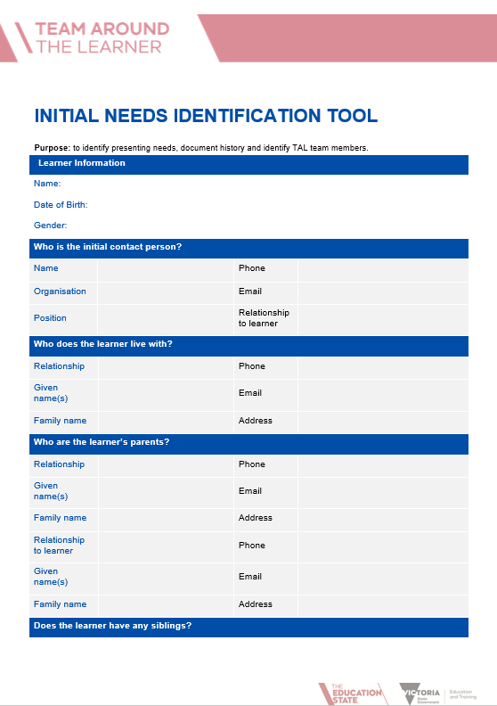
Gathering relevant data and information
Initiate Contact
Plan Transition
A wide range of data and information about the learner will ensure that the team is able to develop an effective plan.
Developing a positive and trusting relationship between the learner, family, school and other contributors will enable the team to put comprehensive plans in place.
Information may be gathered via a broad conversation with the learner and family or may be more structured depending on the relationship.
Documenting and recording information in an agreed template to be shared with the team will provide the basis for future planning. Suggested templates include the Initial Needs Identification tool and Learner Profile.
Information to consider:
learner and family history e.g. who they live with, family structure,
language background. Is there a need for an interpreter?
where does the learner require assistance?
are there other professionals/ agencies/ services involved with the learner and/or family? Obtain contacts and details of supports provided. Negotiate an agreement to share information with these services.
what do the learner and family understand their issues to be?
what are the strengths of the learner?
who would they like to be involved in the Team Around the Learner?
Resources
Initial Needs Identification tool
Learner Profile
Analyse Needs
Monitor & Evaluate
Plan & Coordinate

Slide 5
Organise referrals and assessments
Initiate Contact
Plan Transition
Analyse Needs
Monitor & Evaluate
To gather additional relevant information, the learner may need to
be referred for further assessments.
As the information about the learner is examined, it may be identified that additional
information or assessments would enhance the team’s understanding of needs.
Referrals for additional assessments may be gathered from:
Student Support Services
Allied Health professionals
Doctors/Paediatricians
Mental Health Services
Hospitals
Community agencies
Other Government departments
The Lead Professional will play a vital role in developing the relationship with the learner and family to ensure they understand the importance of the information being sought and to facilitate appointments being made and attended.
Any barriers that might impede these referrals and assessments should be addressed immediately.
Plan & Coordinate
Notes:
Examples of barriers:
the family doesn’t drive and the paediatrician is in the next suburb;
the learner is reluctant to speak with the SSS psychologist on school premises;
the family is reluctant to engage with DHHS after a previous negative experience;
the family does not understand the purpose of the assessment.

Slide 6
Sharing information
Initiate Contact
Plan Transition
Analyse Needs
Monitor & Evaluate
In order for the team to gain the greatest understanding of the
strengths and challenges of the learner, there needs to be an
agreement that relevant information will be shared with those who
need to know.
To obtain informed consent around information sharing:
a positive relationship between all members of the team will ensure that informed consent to share information will be agreed to by all parties
the Lead Professional should take responsibility of forging this relationship
the team should be aware of the confidentiality aspect of the information gathered so that it is only shared with those who need to know
the Lead Professional takes on the responsibility of working through any reluctance to share information with any particular group or organisation
all parties involved in the case should be listed on the Consent to Share Information agreement signed by the learner and family.
Resources
Consent to Share Information agreement
Initial Needs Identification form
Module 5: How does the team share information
Plan & Coordinate

Slide 7


Understanding the learner’s context
Initiate Contact
Plan Transition
Analyse Needs
Monitor & Evaluate
The learner plays a major role in the Analyse Needs phase.
The Team Around the Learner approach clearly shows the learner and family at the centre. The team does not operate without valued input from the learner.
Looking at the needs of the learner without consultation will generally alienate the learner from the process. They will feel being ‘done to’ and will not feel connected to the process.
To make this an enabling process, the learner needs ongoing involvement. This involvement, of course, will be adjusted to suit the age and capabilities of the learner. They will provide information related to needs and wants and will be involved in determining the level of intervention required.
The Lead Professional will play a vital role in ensuring that realistic and feasible needs and wants are included.
Plan & Coordinate
Need
Need
Want
Need
Need
Want
  Example questions for disengaged learner, Brody Smith:
  Who do you connect with at school?
  What classes do you enjoy and engage in? Why?

Slide 8
Understanding the learners context
Initiate Contact
Plan Transition
Analyse Needs
Monitor & Evaluate
Genuine and valued input from the learner will ensure that the needs of the learner are understood prior to any plans being developed and implemented.
The Lead Professional should facilitate a discussion based on the needs of the learner:
consider the family context
capture all identified needs
needs should be written in a clear and concise manner
consider what is realistic, feasible and achievable
the identified needs should be discussed, refined and prioritised with the learner and family
from this list, the team should immediately identify and respond to presenting risks or urgent needs. This may require the creation of a Behaviour Support Plan.
Resources
Behaviour Support Plan
Plan & Coordinate
Need
Need
Need
Need
Need
Need
Urgent
Urgent
Notes:
A potential difficulty with this step is that the number of crises identified may overwhelm the efforts of the team and take away from the focus of the Plan. It is helpful to understand the likelihood of these crises occurring to better understand their priority. The team will need to balance the need to address the most critical risks and urgent needs with the broader Plan.

Slide 9
Accommodating the needs of the learner within the school context
Initiate Contact
Plan Transition
Analyse Needs
Monitor & Evaluate
Every learner is different. In developing the learner’s plan, the team
Needs to consider how the needs of the learner can be accommodated
within the school context.
Completing a comprehensive Learner Profile will provide an opportunity to identify and discuss barriers and strengths that impact on the learner. These are paramount in creating meaningful goals and plans. It is the role of the team to ensure that the needs of the learner can realistically be accommodated.
Making reasonable adjustments
Consultation with relevant teaching staff will ensure that reasonable adjustments can be made within classroom programs to accommodate the needs of the learner.
Where these adjustments cannot be made within the classroom, the team should consider other programs or procedures that can feasibly be put in place to enable the learner to achieve their goals. An Individual Education Plan may be required. These should be detailed within the learner’s plan and clearly identify the rights and responsibilities of all parties.
A current and relevant Student Engagement Policy that is understood by the school community will clearly outline the rights and responsibilities in ensuring a positive culture of engagement in learning in the school.
Resources
Student Engagement Policy -
https://www.education.vic.gov.au/school/teachers/behaviour/engagement/Pages/engagement-policy.aspx
Learner Profile
Individual Education Plan
Plan & Coordinate
Notes:
A comprehensive Learner Profile may include: additional assessments (e.g language, educational), analysis of all school based data and the extensive history of the learner.

