Slide 1
Implementing the Team Around the Learner approach
Module 7
Initiate Contact

Slide 2
Module 7: Initiate Contact
Overview
The aim of this module is to provide individuals with a detailed understanding of how to implement the Initiate Contact phase of the Team Around the Learner approach for improving outcomes for learners and their families. It explains in detail the purpose of the phase, the activities undertaken, who is involved and their roles and responsibilities.
Focus
Completion of this module will support your ability to:
7 Implement the Initiate Contact phase of the Team Around the Learner
An overview of the Initiate Contact phase of the Team Around the Learner
Undertaking the Initiate Contact phase
Roles and Responsibilities
Engaging the Lead Professional
Engaging the other team members

Slide 3
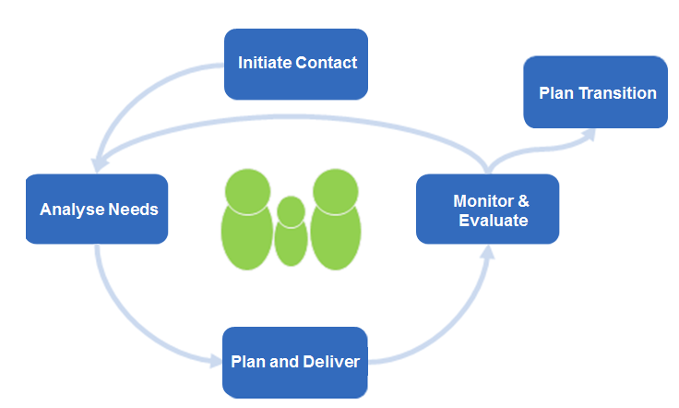
An overview of the Initiate Contact phase The Initiate Contact phase lays the groundwork for the Team Around the Learner approach
Initiate Contact
Plan Transition
Analyse Needs
Monitor & Evaluate
Plan & Coordinate
The person responsible for this phase is someone who has the appropriate
knowledge and skills to initiate the Team Around the Learner process.
As this may be the learner’s first contact with the Team Around the Learner approach, effective communication about the Team Around the Learner approach is paramount.
A trusting relationship is built with the learner and family and the process of engagement commences.
Through contact or appropriate screening tools, the learner is identified as vulnerable and at risk of disengagement, or is already disengaged from learning.
The learner and family are empowered with information and assisted to make the most informed choice for the learner’s needs.
The Initial Needs Identification tool is completed with a thorough history and other information captured to inform future phases.
Engage the members of the team to support the learner and family in this process.
The approach recognises that for each individual, the focus and complexity of need will be different. This will impact on the composition and membership of the team and the choice of Lead Professional.
This phase should begin to emphasise the learner and family’s orientation, as one where they understand that they are an integral part of the process and their preferences will be prioritised throughout the process.
RESOURCES – Initial Needs Identification tool
Notes:
The Initiate Contact phase may be the learner’s first contact with the Team Around the Learner approach. The learner and family are first engaged and oriented with the process and any issues are clarified. It is important that in this phase the level of assistance required is ascertained and a thorough history is captured to inform future phases. The identification of the Lead Professional should be ascertained before the end of this phase. At the outset, a conversation around ‘information sharing’ needs to occur, where the person conducting this phase should obtain formal consent from the learner and family.
Many schools would have the view that every staff member is responsible for this stage.
When a learner first enrols in a school, the classroom/home-group teacher would establish a relationship with the learner and family to gain an understanding of strengths and challenges in learning, development and wellbeing so that a suitable program could be planned and implemented.
If additional needs are detected at any stage, a more formal Team Around the Learner approach would be put in place and suitable team members enlisted to support the learner.

Slide 4
Undertaking the Initiate Contact phase
Initiate Contact
Plan Transition
Analyse Needs
Monitor & Evaluate
Plan & Coordinate
The person who begins the Initiate Contact phase should be someone who cares for, supports or works with the learner, and may be someone from within the education setting.
This person must be able to recognise and articulate the need for a co-ordinated approach to address the learner’s vulnerability and complex needs.
Information is gathered from the learner, family and other support agencies involved with the learner.
Information may be recognised by other people working with the learner as significant and add to the broad range of information to be considered in future phases.
All information is collated in the Initial Needs Identification tool.
The person taking responsibility for the Initiate Contact phase has the appropriate knowledge and skills to begin the Team Around the Learner process.
Notes:
On the simplest level, the Initiate Contact phase would be conducted by the classroom/home-group/wellbeing staff.
If the needs of the learner become more complex, consideration should be given as to who the best person should be to continue this phase to gather all relevant data and information.

Slide 5
Roles and Responsibilities
Initiate Contact
Plan Transition
Analyse Needs
Monitor & Evaluate
The person who takes on the Initiate Contact phase should:
engage with the learner and family, and undertake a face to face discussion
to identify the needs and clarify the issues being experienced.
identify the level of assistance that is required and commence the process of completing
the Initial Needs Identification tool.
introduce the notion of the Team Around the Learner approach as being a way that the learner and family experience a coordinated and seamless service response. Answer any subsequent questions.
engage in a conversation around ‘information sharing’ to explain to the learner and family what information will be collected, why it is being requested, who will have access to it and how it will be stored. The learner and family are asked to formally agree to consent to how the information will be used and with whom it will be shared by signing a Consent to Share Information agreement.
Helpful and effective questions that could be asked to ensure that the learner’s vulnerabilities and signs of disengagement are adequately addressed could be:
Who / which agencies are already involved?
Who else needs to be involved?
How can we form an internal or cross agency team focus?
Who is best placed to play the Lead Professional role?
How can we share information and plan on a needs to know basis?
If barriers to team work or information sharing are significant, does the situation need to be escalated to seek support from an area or regional level?
Plan & Coordinate
Notes:
For more information: https://www.education.vic.gov.au/school/teachers/health/childprotection/Pages/infosharing.aspx

Slide 6
Engaging the Lead Professional
Initiate Contact
Plan Transition
A Lead Professional should be identified as early as possible to
guide the response and collaborative team work.
During the Initiate Contact phase, the Lead Professional is identified as early as
possible to support and steer the process.
In identifying the Lead Professional the following factors should be considered:
who is best placed to take on this role
the relationship with the learner
the level of engagement with the learner and family
frequency of contact with learner and family
the skill level and capacity of the individual to undertake this role.
In some instances the Lead Professional may not be a professional from the education setting, but may be someone who is already involved with the learner and family i.e. a DHHS Case Manager.
If the Lead Professional is not a learning mentor*, it would be beneficial to include him/her in the team.
Decide who will be undertaking the most direct work with the learner. This person/s should not be the Lead Professional as they have a different role, capacity and relationship with the learner.
Resources
Module 3 The Role of the Lead Professional
Analyse Needs
Monitor & Evaluate
Plan & Coordinate
Notes:
On the simplest level, the Initiate Contact phase would be conducted by the classroom/home-group/wellbeing staff.
If the needs of the learner become more complex, consideration should be given as to who the best person should be to continue this phase to gather all relevant data and information.

Slide 7
Engaging the other team members
Initiate Contact
Plan Transition
It is important to consider the composition of the members
of the team.
The Initiate Contact phase lays the groundwork for the collaborative team
work, goal setting and planning that will follow. Therefore the composition of the
team is an essential component.
The tone needs to be set for teamwork and team interactions that are consistent with Team Around the Learner principles to ensure that a trusting relationship and a culture of inclusion is established.
The team is made up of people who are connected to the learner through natural, community and formal support relationships. Examples of team members include the learner and family, education professionals, external community agencies, other government departments, relatives or friends.
The team could include the following:
education professionals: Teacher, Principal, Assistant Principal, Wellbeing Coordinator, Student Support Services Officers
community agencies: advocate, Family Service case manager, counsellor, psychologist, mental health worker
other government departments: Disability Services case manager
The learner and family should be involved in identifying the appropriate members of the team and they should all be listed on the Initial Needs Identification form.
Resources
Module 2 Who is in the Team
Initial Needs Identification form
Analyse Needs
Monitor & Evaluate
Plan & Coordinate
Notes:
The Lead Professional has a pivotal role in ensuring that the learner and family are comfortable in collaborating with all those involved in the case are included in the team so that coordinated and effective support can be promoted.

