Slide 1
Overview of the Team Around the Learner approach
Module 6
How does the team share information

Slide 2
Module 6: How does the team share information
Overview
This module is focussed on understanding how to discuss information sharing with the learner, family and team members. It also covers how to collect, use, store and share information legally and professionally during the Team Around the Learner approach.
Focus
Completion of this module will support your understanding of:
6 How to discuss, collect, store and distribute information legally and professionally
Information sharing in the Team Around the Learner approach
Informing the learner, family and team members about how information will be used
Collecting, sharing, using and storing information

Slide 3
Information sharing in the Team Around the Learner approach
Information sharing is critical to the delivery of the Team Around the Learner approach.
Information sharing will occur throughout the entire Team Around the Learner approach. It plays an important role in providing a seamless coordinated service by reducing duplication of effort, removing barriers to effective communication and enabling better discussions through sharing of ideas.
The type of information collected and shared during the Team Around the Learner approach may include:
relevant and critical information on needs and history, reports and assessments
past and current services and supports
meeting minutes
outcomes from monitoring and evaluation
consent to share information
the Individual Education Plan and learner profile

Slide 4
Information sharing in the Team Around the Learner approach
As a learner, family, team member or Lead Professional, it is important to understand the role that information plays in enabling the Team Around the Learner approach.
Information is collected in the Team Around the Learner approach in order to:
understand who should be part of the team
determine the supports and services that are required
comprehend what assessments, interventions and referrals need to be made and why
develop a relevant and effective plan
monitor and evaluate the progress of team member’s
actions against goals and strategies.
Here are some points to help you discuss information sharing with the learner and family:
Explain that information collected will only be used for the primary purpose for which it was originally provided.
If it is used for a secondary purpose, consent will be obtained.
Ask the learner and family if they understand the reasons why information sharing is important.
Information will only be shared with those who need to know.
The Lead Professional works with the learner and family to obtain consent for information to be collected, shared, used and stored.
The initial contact person or Lead Professional in the first phase of the approach needs to discuss information sharing with the learner and family to ensure they understand what is being asked of them.
https://www.education.vic.gov.au/school/teachers/health/childprotection/Pages/infosharing.aspx

Slide 5
Collecting, sharing, using, and storing information Information obtained from the learner and family will be used in different ways throughout the Team Around the Learner approach.
Collecting
Sharing
Using
Storing
Notes:
Consent is inherently understood to be part of the data collection process

Slide 6
Collecting Information .
An agreement to Consent to Share Information should be used to capture all and any consent given by the learner and family for their information to be shared.
This Consent to Share Information should be completed in the Initiate Contact phase by the initial contact person or Lead Professional.
This form will be updated during all stages of the Team Around the Learner approach as new members join the team. The Lead Professional should ensure that:
All team members, services and supports are familiar with this
The agreement is reviewed and updated regularly.
Information can be collected through:
existing documents or publications: such as previous care plans used by the learner and family
oral conversations: such as group meetings
observations: such as daily interactions with the learner, family and team members.
Notes:
Because there might be a range of people (advocate, footy coach, DHHS Case Manager, community agency, doctor ) within this ‘team’, this form clearly lists all who are involved have agreed to share info.
Information sharing can occur without the consent of the learner or family if the information is being shared with other statutory services or if it is in the best interests of the learner and family. If the learner and family do not have capacity to consent then it must be sought from an authorised representative on behalf of the learner and family.

Slide 7
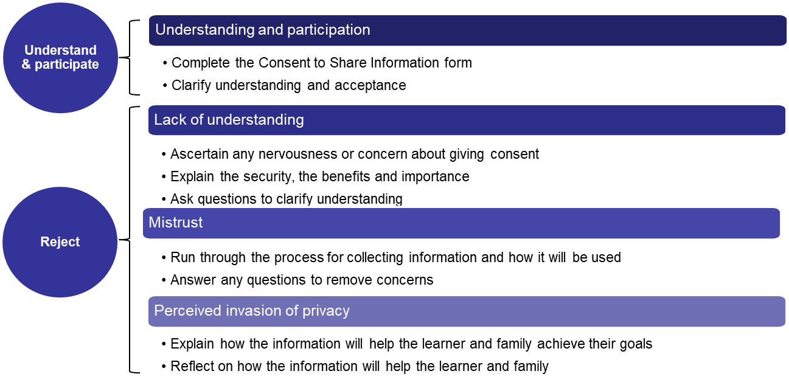
Sharing Information
Learners and families may accept or reject information sharing for various reasons. Some of the common actions to assist with these issues are:
Notes:
Good communication and the development of a trusting relationship is key to information sharing

Slide 8
Using Information
Information should always be used in an ethical and professional manner that meets the requirements of the Privacy Act.
The information that is collected during the Team Around the Learner approach must be used ethically and in accordance with the Information Privacy Act 2000. The primary use of information during the Team Around the Learner approach is to assist with coordinating support for the learner and family throughout the Plan.
The Lead Professional plays an important role when informing the learner and family that their information will be used and in some cases shared with others.
It is important to ease the concerns of the learner and family which can be done by:
only using information for its intended purpose as outlined in the Consent to Share Information agreement
informing the learner and family and obtaining consent should the information be needed for other purposes unrelated to the Team Around the Learner approach
Who can access the information?
Information should only be used by those who require access to it in order to conduct activities within the Team Around the Learner approach. This may include the learner, family and team members where required.
The learner and family may access personal information and seek corrections should any information be incorrect or inaccurate.

Slide 9
Storing Information
Storing Information
It is the role of the Lead Professional to ensure that the information collected throughout the Team Around the Learner approach is securely stored.
It is important that the learner and family are provided with opportunities to review any documents and forms that are completed and that they are comfortable with the information before approving its content.
It is the responsibility of the school to create, manage and dispose of public records (electronic and hardcopy) in accordance with the standards set by the Public Record Office Victoria and guidelines issued by the Department.
In accordance with the Public Record Office Victoria, the department is to securely store the following records: request for services, referrals made by professionals in contact with the children, parental/ carer consents and records documenting progress. These records are to be destroyed 7 years after the last service is completed, provided the learner has attained the age of 25 years.

