Slide 1

Overview of the Team Around the Learner approach
Module 5
The role of the team

Slide 2
Module 5: The role of the team
Overview
This section focuses on clarifying and describing the role and expectations of those who make up the support team for the learner. As outlined in Module 2, teams are made up of people who are connected to the learner through natural, community and formal support relationships. Examples of team members include the learner and family, education professionals, external community agencies, other government departments, relatives. It is important that the team are able to put aside individual agendas to work collaboratively for the best outcomes of the learner.
Focus
Completion of this module will support your understanding of:
5 How to work collaboratively as part of a learner’s support team
Working collaboratively as a part of the learners support team
Understanding the role of feedback
Providing feedback
Receiving feedback

Slide 3
Working collaboratively as a part of the learner’s support team
Teamwork is the cornerstone of the Team Around the Learner approach.
Teamwork is the reason why this approach works in meeting the needs of the learner and sustaining them in education. The team is required to effectively collaborate and connect with each other with the primary focus on the learner’s positive educational outcomes.
Working collaboratively as a team requires the team members to:
Be able to recognise the need for a co-ordinated service and support approach
Work to freely articulate their knowledge and views regarding the learner (fully participate)
Be able to listen respectfully to all views of team members (respect the opinion of others)
Uphold the Team Around the Learner key principles
Work with others to develop a coordinated plan
Support the Lead Professional where required
Commit to meetings and actions as determined by the group
Share ideas and collaborate with other team members
Remain accountable for their actions
Work with families because of the learner’s specific needs and to help the learner engage in education
Be sensitive to the context of the family as it relates to the learner’s ability to engage in education

Slide 4
Working collaboratively as a part of the learner’s support team
The following pages outline the responsibilities of the key roles in each phase of the Team Around the Learner approach.
Members of the support team must engage in all phases of the Team Around the Learner approach. The following table (from Module 2) highlights some activities that a team member might engage in throughout the approach.
Phases of Team Around the Learner
Initiate Contact | Analyse Needs | Plan & Coordinate Support | Monitor & Evaluate | Plan Transition
Be open to participating in the Team Around the Learner process as required | Participate in team activities as required Assist in conducting needs analysis where able and required | Contribute to the development of a Plan Conduct roles and responsibilities as outlined in the Plan Support the Lead Professional Work as part of a team, cooperating and communicating with others Uphold the principles of the Team Around the Learner process Attend meetings | Uphold roles and responsibilities Communicate the progress of actions and strategies with the Lead Professional and other Team members in a timely manner Continue to implement the Plan Attend and participate in team meetings and activities | Participate in the development of the Transition Plan Celebrate successes Continue to support the learner and family as required

Slide 5
Understanding the role of feedback
Feedback is the process of passing information from one person to another about the effectiveness of the interventions that have been put in place. It involves open communication between all members of the team.
It is essential that the communication is not seen as one way.
Feedback is a powerful tool that can be used to:
encourage and confirm that the team is on track
provide insight as to how the learner, family and team members are working and feeling
increase motivation and team satisfaction
increase feelings of involvement
assist with measuring outcomes of actions and strategies
help identify improvements to increase the effectiveness of strategies, actions and teamwork

Slide 6
Maximising the impact of feedback
For feedback to be effective, there are a number of forms that it should take.
During the Team Around the Learner approach, the Lead Professional will provide feedback to the learner, family and team members to inform them about their actions, strategies and behaviours. Team members can also provide feedback to improve the team's ability in achieving learner goals.
The number one rule for providing feedback is:
Try to make it a positive and constructive process and experience
Some tips for delivery include:
Prepare your comments
Be specific
Focus on feedback that looks for improvements
Use "I" statements to avoid labelling the person
Provide specific suggestions
Follow-up
Goal Driven
Is two way
Focuses on a behaviour not an individual
Effective Feedback
Is specific
Is objective
Is timely and specific
Notes:
Goal Driven: Refer back to the goals and vision
Actionable: Ensure that the feedback is actionable and specific
User Friendly: Use simple language to ensure that the learner, family and team members understand what is being said. Avoid technical jargon
Timely: Ensure that the feedback is timely. In most cases, the sooner the better. Feedback should be provided in an appropriate environment
Consistent: Feedback should be consistent and fed back to the team in a stable, accurate and trustworthy way.
Ongoing: Feedback should be open and encouraged through the Team Around the Learner approach. This ensures that the learner, family and team members have opportunities to take it on-board and practise it.

Slide 7
Providing feedback
Feedback is given to provide insight into a particular task, action and/or behaviours that was done well or that need improvement.
This can reinforce a behaviour or help people to determine an alternative way of working
There are two main types of feedback that people most often use:
Positive Feedback: affirming comments about the impact of behaviour or actions. These are things that went well and should be repeated.
Feedback for Improvement: comments that outline less effective outcomes of a task or action; or the impact of behaviours. Alternative strategies or actions are suggested to improve things for the future.
Positive Feedback
Feedback for Improvement
"You did a great job helping the learner complete that action"
"When you use simpler language, it is a lot easier to understand what you are saying"

Slide 8
Providing feedback
Depending on the situation, providing feedback can be challenging.
Below are some commonly faced stumbling blocks and tips on how to overcome them.
Tips
Stumbling Blocks
General comments
  Always link constructive feedback to a situation
  Keep feedback specific and actionable
  Use examples
Personal comments
  Keep comments relevant to the task at hand
  Keep comments focused on things that can be changed
A strong focus on negativity
  Start with strengths
  Focus on improvements
Accusation
  Use language that starts with "I…" e.g. "I think that…" or "I felt that…" rather than "You have…"
Feedback overload
  Keep feedback targeted to avoid overloading the team with information

Slide 9
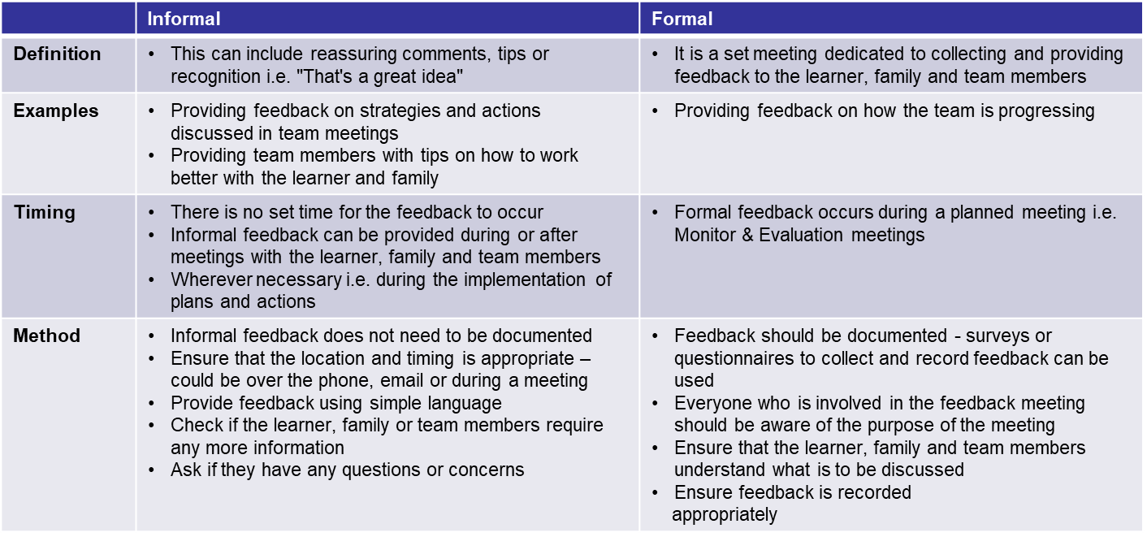
Providing feedback
Depending on the content of the discussion, feedback can be delivered informally or formally.
Providing feedback can be informal or formal. The method will depend on what is being discussed and in what context.
Examples of informal and formal feedback during the Team Around the Learner approach are provided below:

Slide 10
Providing Feedback
The tips on this page will support you in providing feedback for improvement.
It is probably safe to say that it is the delivery of feedback for improvement that can elicit some undesirable reactions from the recipient. Some people have a very difficult time dealing with feedback for improvement.
The recipient may:
Question your comments
Become upset or emotional
Make a complaint
In these circumstances, it is important to immediately address any concerns the recipient has. This can be done by:
Reassuring them of the things that they are doing well
Explaining that feedback is a normal part of the Team Around the Learner process to support the team in delivering on the learner's needs
Providing further clarification regarding your comments
Giving the individual time to calm down
Offering support
Focusing on the improvement rather than the issue

Slide 11


Receiving Feedback
Feedback can be collected during:
Meetings with the learner, family, and team members
Phone calls with the learner, family, and team members
Forms
Surveys or questionnaires
All team members should recognise that feedback can also be:
An initial reaction during or following an action, activity or idea
Verbal conversations
Observations (body language and facial expressions)
Surveys and forms can be used for recording feedback. These should be clear, easy to understand and appropriate for the audience.
Open Discussions
You may want to ask questions like:
  Am I doing this correctly?
  Is there another way I can do this?
Surveys & Questionnaires
The structure and type of survey should be specific to its target audience

Slide 12

Receiving feedback
It is important to practice self-reflection to continuously improve the way each team member conducts themselves.
Reflective practice involves taking the time to think about different aspects of the role of team members and what can be done better. It is a form of providing feedback to yourself.
Reflective practice in the context of the Team Around the Learner approach can be the most important source of personal professional development and improvement.
Self reflection can be achieved by:
Reflecting on your work and seeing if there are any improvements that can be made
Listening to feedback from others
Taking on training opportunities to continue your development
Questions you can ask yourself include:
How did I decide to do things this way?
Who benefits from the way I do things?
Can I do it better in a different way?

