Slide 1

Implementing the Team Around the Learner approach
Module 11
Plan Transition from Additional Support

Slide 2
Module 11: Planning Transition from Additional Support
Overview
The aim of this module is for the team to identify when to plan the transition from additional supports for the learner and family. This module outlines how to develop the Transition from Additional Support Plan. The module will also discuss the importance of celebrating successes with the learner, family and team, and how to check in with the learner and family to ensure continued success.
Focus
This module will support your ability to:
11 Plan Transition from Additional Support
Recognising when to plan transition
Developing a transition from additional supports plan
Celebrating success
Following – up with the learner and family

Slide 3
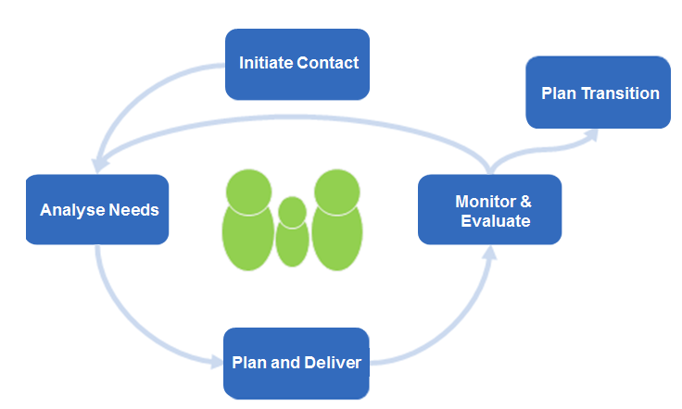
Recognising when to plan transition
Initiate Contact
Plan Transition
Analyse Needs
Monitor & Evaluate
Plans are made for a purposeful transition from the formalised Team Around the Learner approach to reengagement in natural supports.
This phase is entered once it has been agreed by the learner, family and team that the goals outlined in the plan have been achieved and sustained.
A Transition from Additional Support Plan is created taking into consideration the need for post-transition planning.
The Team Around the Learner process is formally concluded with a celebration of the achievements of the learner, family and team.
Resources
Transition from Additional Support Plan
Plan & Coordinate
Notes:
The transition phase IS NOT related to the transition a learner may make from one year level to the next; from primary to secondary school; or from secondary school to work or further education.
This phase is all about how the learner transitions from having additional supports and interventions to being able to satisfactorily manage his/her own success.

Slide 4
Recognising when to plan transition
Initiate Contact
Plan Transition
Analyse Needs
Monitor & Evaluate
By this stage the learner and family will be equipped with the knowledge and coping skills to manage situations as they arise and feel that their needs have been met.
Plan & Coordinate
The activities of this phase have no defined timeline.
At this stage, the learner and family are confident to contact the appropriate supports if required.
The learner and family should be followed up to ensure that they are continuing to experience success after the Team Around the Learner process concludes. The Lead Professional should provide support if it becomes necessary again.
It is acknowledged that crises and other events that occur in the learner’s life may flag a need for an increased level of support. At these times the Team Around the Learner approach may need to be reinstated to support the learner.

Slide 5
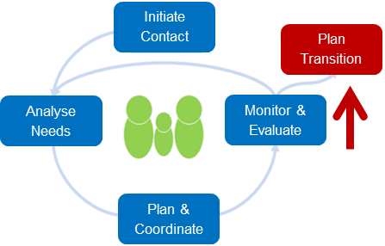

Recognising when to plan transition
Preparation for the transition process commences well before the actual phase begins and intensifies as the team moves closer to achieving all the goals and needs of the learner.
During the implementation of the plan, the Lead Professional and team are continuously monitoring and evaluating the success of the strategies and the goals being achieved. At this time, they are also carefully monitoring if the learner and family are:
learning new skills to cope with and manage their needs
gaining knowledge of how to access supports and services
building and using their strengths
sustaining the outcomes achieved along the way.
Once it has been agreed during the Monitor & Evaluate phase that all goals have been achieved and the needs of the learner have been met, the team should come together to discuss the development of a Transition from Additional Support Plan.
The Lead Professional should schedule a meeting with the team to review the outcomes of the learner. It is important to ask the learner and family how comfortable they are to move into the Plan Transition phase and feel they are capable of supporting themselves.
Strategies were successful
Goals have been achieved
Needs have been met

Slide 6

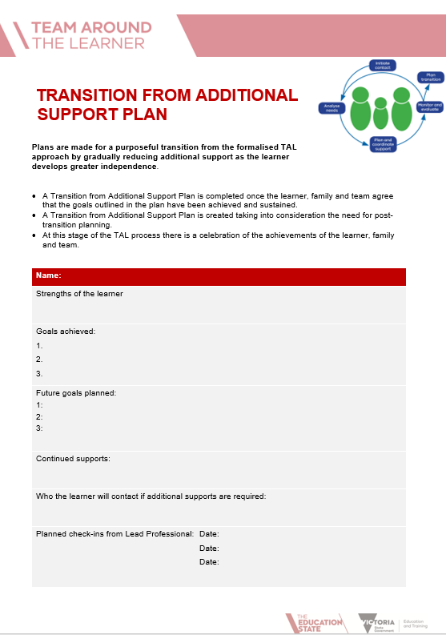
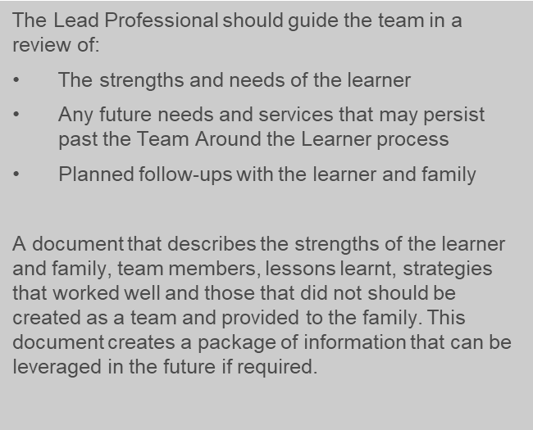
Developing a Transition from Additional Support Plan
Planning the transition will involve the development of a Transition from Additional Support Plan with the learner, family and team.
Resource
Transition from Additional Support Plan

Slide 7


Celebrating success
The transition should be celebrated as a team in recognition of the journey everyone has travelled together and the success that has been achieved .
The Lead Professional should encourage the team to celebrate the transition in a culturally appropriate manner that:
is meaningful to the learner, family and team
recognises accomplishments
highlights the journey that has been travelled together
It is important this step does not feel like it is simply part of the process but a genuine celebration of success

Slide 8
Following-up with the learner and family
The Lead Professional should lead the team in establishing a procedure for
periodically following up with the learner and family during the transition phase.
Check-ins should be intermittent and should have an end point depending on how the learner and family are progressing post Team Around the Learner. If, during these follow-ups, new needs have emerged to the degree that a Team Around the Learner would be required, the Lead Professional should make the appropriate arrangements and reconvene the team.
Intervention may not need to be as formal as beginning a Team Around the Learner process and the Lead Professional may guide the learner and family to other appropriate services and supports that could meet their needs. The learner and family should always feel that they know who they can go to for support, guidance or assistance and feel comfortable to do so.
Depending on the team involved in the Team Around the Learner and the Transition from Additional Support Plan, check-ins can be part of existing school, family and learner conversations. The learning mentor* plays a major role in monitoring the ongoing wellbeing and learning direction of the learner. The Lead Professional should provide support where necessary.
It is acknowledged that crises and other events that occur in the learner’s life may flag a need for an increased level of support. At these times immediate supports need to be put in place and the team reconvened to support the learner.
Notes:
Learning mentor – classroom teacher, year level co-ordinator, wellbeing staff, trusted school staff member. This is usually someone who has the closest connection with the learner to support him/her in accessing learning.

