Slide 1
Implementing the Team Around the Learner approach
Module 10
Monitoring and evaluating progress of the plan

Slide 2
Module 10: Monitoring and evaluating progress of the learner’s plan
Overview
The aim of this module is to provide the team with an understanding of the approach to monitoring and evaluating the progress of the learner’s plan. The module details how and when progress review meetings should be held with the team; discusses how to evaluate progress against the plan and make changes where necessary; and outlines the importance of maintaining relationships and stakeholder buy-in during implementation.
Focus
This module will support your ability to:
10 Monitor and evaluate the progress of the learner’s plan
Overview of the Monitor and Evaluate phase
Conducting progress review meetings
Assessing and evaluating progress against the learner’s plan
Maintaining relationships and stakeholder buy-in

Slide 3
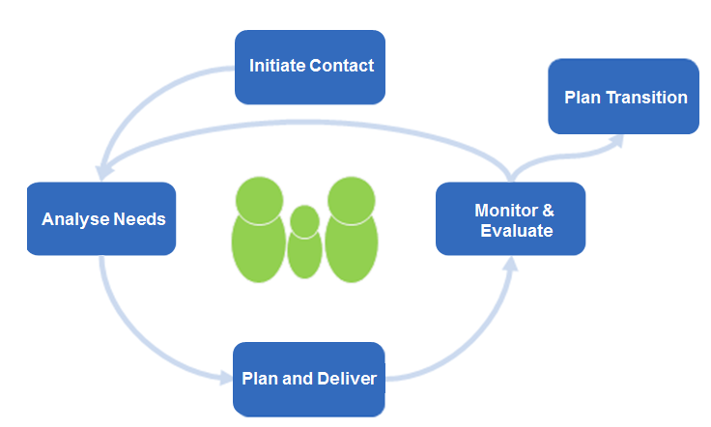
Overview of the Monitor & Evaluate phase
Initiate Contact
Plan Transition
Analyse Needs
Monitor & Evaluate
The Monitor and Evaluate phase involves careful monitoring of strategies and actions to achieve the learner’s goals that were developed in the Plan and Coordinate Support phase.
Plan & Coordinate
This is vital to the success of the Team Around the Learner approach.
This module will look at how the team will monitor and evaluate:
the achievements of the learner
the strategies and actions that are proving to be successful
the strategies and actions that aren’t working well and need to be rethought
any changing circumstances for the learner that need to be accommodated
As a result of this monitoring and evaluation, the team will:
recognise and celebrate successful achievements
adjust the plan to suit current needs and aspirations
enlist the support of additional or different team members

Slide 4
Conducting progress review meetings
Initiate Contact
Plan Transition
Analyse Needs
Monitor & Evaluate
Careful monitoring of strategies and actions in meeting the needs of the learner is vital to the success of the Team Around the Learner approach.
Plan & Coordinate
The Monitor & Evaluate phase is about continually reviewing the progress and success of the goals, strategies and actions defined in the learner’s plan.
In this phase the Lead Professional facilitates the discussion as the team monitors and evaluates their efforts. The frequency of review meetings is determined by the nature of the goals and strategies defined in the plan.
During this phase the team will monitor and review the:
progression of actions and strategies
achievement or relevance of goals
team satisfaction and buy-in
team cohesiveness
The activities of this phase are repeated until the learner's goals have been achieved and that everyone agrees that the Plan Transition phase should begin.

Slide 5
Conducting progress review meetings The Lead Professional will schedule team meetings to review progress on actions agreed to in the plan.
1
Follow up with team members on actions to ensure they have been completed according to agreed timelines
2
Schedule a progress review meeting for the team to track progress of actions and strategies against indicators of success
5
3
4
Identify any road blocks or changes in circumstance and discuss as a team a strategy for moving forward
Make changes to the plan or revisit previous phases if required
Document and distribute the updated plan after each meeting

Slide 6
Conducting progress review meetings
Initiate Contact
Plan Transition
Analyse Needs
Monitor & Evaluate
The regular monitoring of actions will ensure that
strategies are being implemented in a timely manner.
There are no defined timelines for when actions and strategies should be reviewed. However they should be completed at regular intervals as defined by the Individual Education Plan. This is dependent on the nature of the goals and strategies that have been developed with the learner, family and team.
The date of the next team meeting should be agreed and recorded in the minutes.
Actions and strategies can be intermittently monitored by the Lead Professional through:
telephone calls
emails
informal check-ins with the learner to maintain commitment to goals
Resources
Meeting agenda/minutes template
Individual Education Plan
Plan & Coordinate

Slide 7
Assessing and evaluating progress against the learner’s plan
Initiate Contact
Plan Transition
Analyse Needs
Monitor & Evaluate
Review of actions
You may want to ask questions such as:
Have the actions been completed?
Is there progress on the action?
Why has the action not been completed?
What other actions are required to continue supporting the strategy?
Review of key indicators of success towards goals
You may want to ask questions such as:
Are the strategies that are being implemented moving the learner closer to achieving the goals?
Are the learner's goals still relevant to his/her needs?
Are there any additional needs that have since surfaced that may need to be addressed?
Have we achieved any of our goals?
Plan & Coordinate
Has it been completed?
Actions & Strategies
What’s working well?
Do we need a new strategy?

Slide 8
Assessing and evaluating progress against the learner’s plan
Initiate Contact
Plan Transition
Analyse Needs
Monitor & Evaluate
The Individual Education Plan should be used to determine, track and evaluate the strategies and actions planned to support the learner’s goals against the agreed timelines.
Plan & Coordinate
Meaningful discussions about the impact of the strategies and actions will provide constructive feedback within the team.
From this, the team can make a decision on the effectiveness of current strategies and what the next steps should be.

Slide 9
Assessing and evaluating progress against the learner’s plan
The learner, team and Lead Professional will need to regularly make changes to the initial plan.
The Lead Professional will help the learner, family and team members respond to changes in circumstances (such as changing needs, additional needs, unsuccessful strategies, achievement of goals, the need for new aspirations).
Depending on the situation, other phases may need to be revisited. This will be determined by the team’s perception of success.
The following table describes some of the issues that may be faced during implementation, their potential causes and possible solutions:

Slide 10
Making changes to the learner’s plan The plan should be updated to reflect changes discussed and agreed in the review meetings.
Initiate Contact
Plan Transition
Analyse Needs
Monitor & Evaluate
Plan & Coordinate
Updating the learner’s plan
Any changes that are required to be made to the plan are discussed during the meeting, documented and implemented as a team.
Changes can include those to:
needs
goals
actions and strategies
team roles and responsibilities
The plan should also include comments as to why any changes were made. In the future this will provide the learner and family with a document of lessons learnt for future reference.
A copy of the previous plan should be maintained for record keeping. The updated version should be distributed to the team by the Lead Professional after the meeting.
Sharing changes with the team
The Lead Professional should ensure that all documentation including the learner’s plan, information sharing consent agreement and other relevant documentation are current and distributed to the team where appropriate and in a timely manner.
Team documentation should record:
the completion of steps
changes to goals, strategies or actions
new roles and responsibilities
team attendance to meetings
communications

Slide 11
Maintaining relationships and stakeholder buy-in
Initiate Contact
Plan Transition
Recognition of strategies that have been successful and the goals achieved is a valuable way of sustaining momentum and buy-in.
When a strategy is successful in moving towards a goal or a goal is achieved it should be celebrated to show that the effort and support of the team has been recognised. Regardless of size or impact, it is important to recognise when goals have been accomplished and achieved.
Analyse Needs
Monitor & Evaluate
Plan & Coordinate
The effects of celebrating success with the team include:
encouragement of a strong positive culture that reinforces positive behaviours
reminder of the importance of the Team Around the Learner approach
increasing team bonding and unification
re-energising the learner, family and team
feeling appreciated for efforts
"Success breeds success"
maintaining the learner, family and team members’ buy-in
Celebrations come in different forms:
Verbally acknowledging when an action is completed
Sending out an email to the team congratulating them on an achievement

