Slide 1









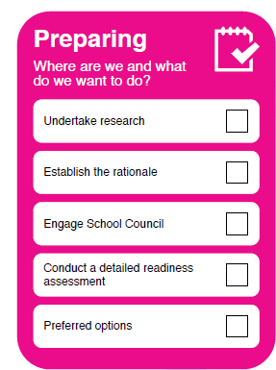
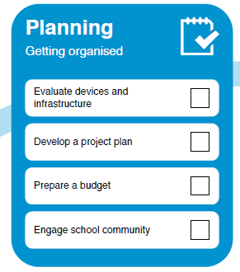
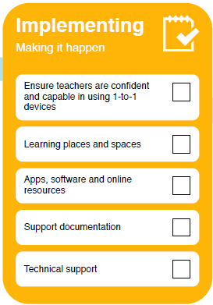
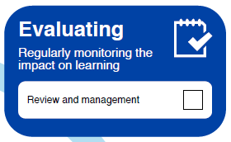
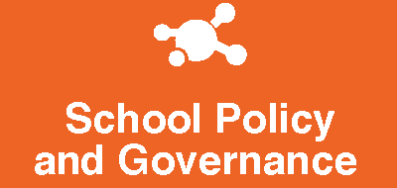
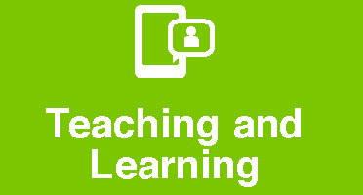





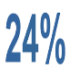
Considering a 1-to-1 learning program? (Personal devices)
Digital technologies can provide learners improved access to quality educational resources, increased learning opportunities through virtual experiences, support immediate feedback and assessment, and enable learners to manage their learning tasks and progress.
The Department of Education and Training does not stipulate that a school must have a 1-to-1 program nor does it mandate a preferred provisioning model (i.e. BYOD, co-contribution or school-funded).
What are the benefits of a 1-to-1 learning program?
What principles govern school practice?
Educational value | Access, Equity and Inclusion | Affordability
Engagement & Support | Respect & Confidentiality | Transparency & Accountability
What are the elements to consider when planning for 1-to-1?
What’s happening in Victorian government schools?
of Victorian Government schools have a 1-to-1 program (89% secondary and 44% primary)
of the schools with a 1-to-1 program – Year 7 has the highest implementation at 87% (varying from 20% 1-to-1 for preps to 78% in Year 12).
In 2015, of the schools with 1-to-1 programs, 24% BYOD, 27% were school funded, 16% were co-contributions from parents, and a combination of all 3 accounted for the remainder
of schools with 1-to-1 programs have managed devices (students have some ability to change settings/install applications), with 34% restricted access
of parents think that digital skills and computer programming should be integrated into primary and secondary curricula (NICTA)

Slide 2
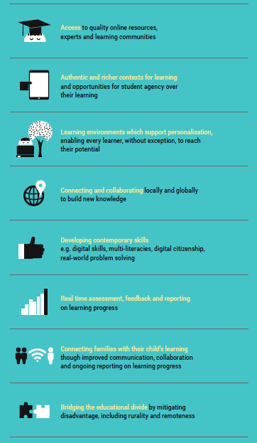
Ways schools are using digital technologies in learning
Benefit | Example of uses in schools
Access | Students accessing specialised online learning resources for practice or extension e.g. Kahn Academy, Reading Eggs and or design and creation e.g Tinkercad or Powtoon Students using e-textbooks that can offset device costs and allow for annotations and searches. Students engaging with quality experts through webinars, podcasts, live forums, online conferences to gain broader perspectives about their learning.
Authentic learning | Students going on virtual excursions or simulations to gain richer understanding of contexts/environments and offsetting excursion costs Students participate in collaborative global projects e.g. Global classrooms to develop robust solutions to world issues and critical communication and citizenship skill sets Students accessing live data e.g. weather, economic, live tracking, demographic statistics to add evidence (validate/substantiate) their work and claims or contributing ideas and opinions to construct
Personalised | Students have a choice in using multiple ways of learning/representing their understanding through film, songs, podcast, infographics naturally catering for individual learners Students can self-manage their learning using electronic diaries/calendars, submission trackers Students can access specialised online support e.g. aides, career advisors, gifted programs Students participate in authentic tasks which motivate investigation and provide opportunity for student voice
Collaboration | Students can co-create content / problem solving with peers (team work) using shared platforms e.g. Google docs, wikis, blogs Students can use web conferencing/Skype to connect to students / teachers / future employers gaining important global citizenship skills Students engaging in learning communities to gain multiple perspectives and leverage different skill sets
Contemporary and digital skills | Students using digital technologies in their learning provides the opportunity to build digital skills - word processing, spreadsheets and database skills and for constructing knowledge and creating rich productions Students viewing multiple and varied representations of concepts helps students to grasp complex material Students using subject –specific software for refining special skills – e.g. mathematical modelling, pronunciation checkers for language learning Opportunities for student participation in authentic tasks with opportunity for real world action e.g Change.org
Assessment and feedback | Class polling and online discussion increases participation rates and engagement e.g. Kahoot, Padlet, Verso Self-paced, self correcting modules and courses offer students immediate feedback enabling earlier intervention Peer/expert feedback on student blogs teaches learners the value of receiving feedback and revising work Adaptive testing/tasks allows every student to work to their level and make progress i.e. no need to sit out/be frustrated by content outside a student’s ability. Opportunities for students to present their learning in new ways e.g film and present their understanding of concepts, processes and relationships
Connecting with families | Students participating in 3 way (parent-teacher-student) conferencing to present their portfolios gives them responsibility over their learning and understanding of the progress they have made Students (and parents) can access their progress data/reports/previous work through Learning Management Systems e.g. Edmodo, Compass Parents can comment on class blogs assisting with the learning and showing interest in their children’s education.
Bridging the divide | Students can access subjects not offered at their school through virtual learning Assistive function/devices e.g. screen enlargers, voice recognition can offer students with disabilities more opportunities to participate in learning Access to devices at school offers students with no home access the chance to develop digital literacy skills and online opportunities afforded to their peers.
For more information access;
Planning for 1-to-1 Learning DigiPub resource – http://www.digipubs.vic.edu.au/pubs/planning-for-1-to-1/planning-for-1-to-1-overview
The Department offers practical workshops to guide schools through developing their ICT Plan and specific workshops on developing a plan for implementing 1-to-1 learning programs to register your schools interest email: digital.learning@edumail.vic.gov.au

