Slide 1
Improving recognition of and response to child vulnerability – the development of the Greater Shepparton Vulnerability Guide
State –wide Maternal and Child Health Conference
September 18th 2014

Slide 2
Enhanced Best Start – a focus on two indicators
Improved rates in the initiation and duration of breastfeeding
Increased participation rates in maternal and child health and kindergarten services for vulnerable children and families; with a particular focus on children referred to Child Protection and/or Child FIRST

Slide 3
Project details
We are one of the two sites being funded for Enhanced Best Start – the other is Mildura
Project timeline Jan 2011 to June 2014
Total funding of $700,000 - $350,000 for the MCH/Kinder indicator
Enhanced Best Start Reference Group - established in April 2011

Slide 4
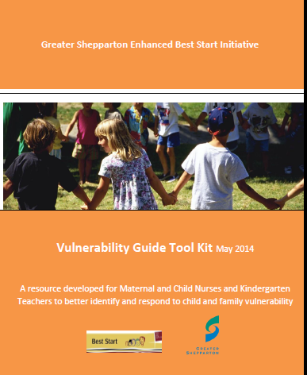
MCH Programs / Activities
Professional Development
Vulnerability Guide
MCH Outreach Home Visiting
Ready Services Audit

Slide 5
Three priority areas
Greater understanding and identification of child and family vulnerability factors
Bridges out of Poverty Training, Vulnerability Guide
Increasing the capacity of MCH /kinder services to better with engage and support vulnerable families
MCH outreach, 1:1 kinder interviews
Conduct ‘Family friendly’ services review and take action in relation to identified issues
Ready Services Audit

Slide 7
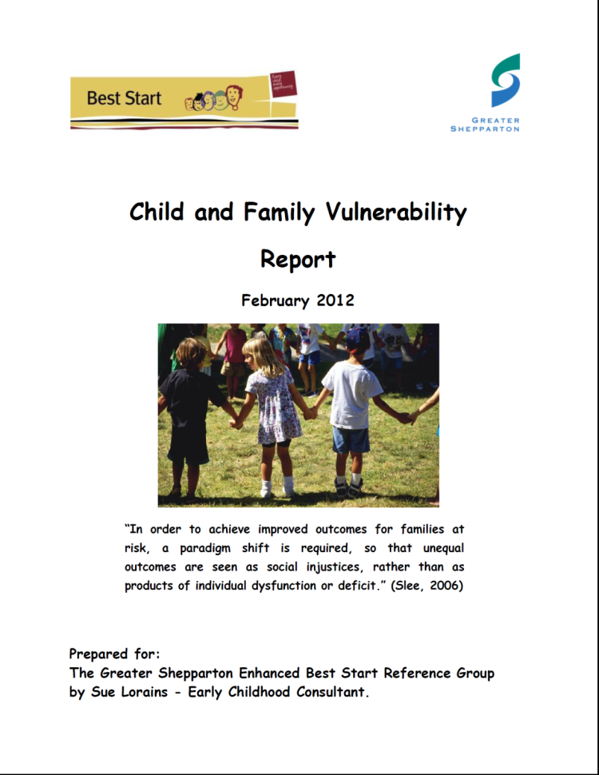
The Vulnerability Tool becomes the Vulnerability Guide Tool Kit
2011/12
Research in relation to how
vulnerability was defined
and what already existed in
relation to practice ‘tools’
Developing a tool for facilitating
a shared/common
understanding of
child and family vulnerability

Slide 8
The Vulnerability Tool becomes the Vulnerability Guide Tool Kit
2011/12
Setting up Xpedite data fields
Staff training March 2012
Implementing The Vulnerability Guide Version 1 within MCH and Kinder services
Initial Data cleansing

Slide 9
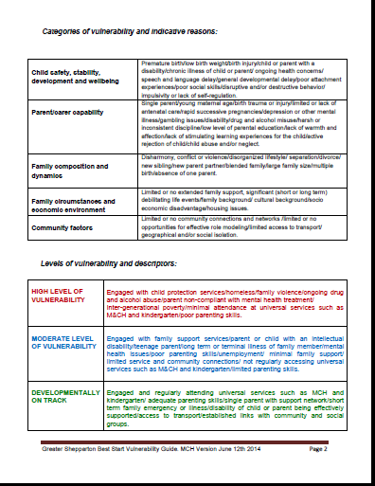
5 domains of vulnerability factors
MCH Nurse considers level of vulnerability and what response is required

Slide 10
The Vulnerability Tool becomes the Vulnerability Guide Tool Kit
2013/14
Refinement of the Guide in consultation with MCH Nurses – workshops, reflection sessions
Discussion of issues raised by nurses
Revision of Vulnerability Guide 2 versions MCH version and kindergarten version

Slide 11
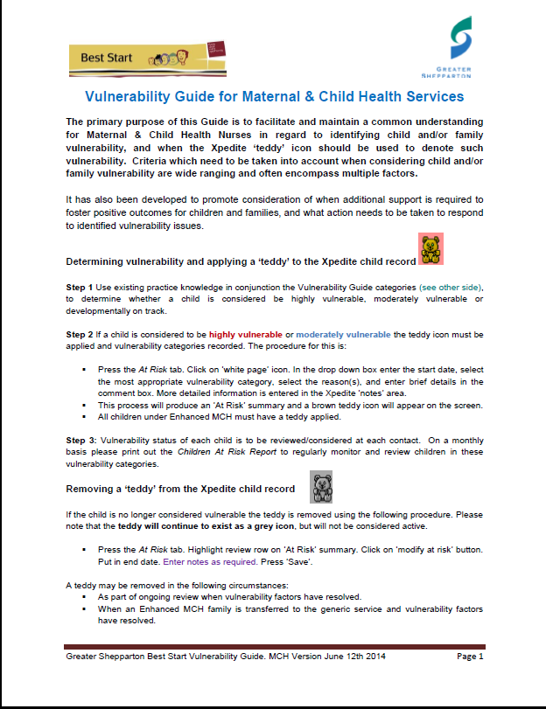

Slide 12
The Vulnerability Tool becomes the Vulnerability Guide Tool Kit
2013/14
More data cleansing with agreed terminology
and processes to note why teddies had been removed.
Development of Tool Kit and process for sharing the resource. Training seen as a critical element.
Aiming for completion in October 2014. Training
offered November 2014.

Slide 13
The Vulnerability Tool becomes the Vulnerability Guide Tool Kit
Web based with links to key resources
Section 1: Background information, rationale, lit review
Section 2: Vulnerability Guide and Training Modules
Section 3: Examples of Application and Data Use

Slide 14
What impact has it had?
Our local EBS evaluation questions
Have MCH and kinder staff developed greater knowledge and skills in relation to understanding and responding to child and family vulnerability?
In what ways and to what degree have MCH and kinder services been successful in increasing access and participation for vulnerable families and children?

Slide 15
What impact has it had?
Improved identification of and response to vulnerability
Valuable alert on client data base as to existing vulnerability issues
‘It is really useful – you know straight away that there are factors that you need to be aware of’
Prioritises who needs to be followed up – Xpedite Child at Risk Reports
A key tool in determining outreach home visits

Slide 16
A cultural shift within the MCH service. Thinking more broadly as to ‘what it takes’ to engage successfully with vulnerable families.
For example – outreach home visiting
‘It is really working – we are seeing families we would not normally be able to engage’
‘We really need to think about the fact that outreach work is as important as working in the centre.’

Slide 17
Increased engagement of vulnerable families
Key Ages and Stages Visits Mooroopna – Morrell St MCH Centre
 | HV | 2wk | 4wk | 8wk | 4mth | 8mth | 12mth | 18mth | 2yr | 3.5
11/12 | 99% | 94% | 81% | 85% | 78% | 70% | 62% | 63% | 49% | 53%
12/13 | 103% | 101% | 98% | 111% | 90% | 79% | 85% | 85% | 86% | 80%
13/14 | 85% | 88% | 94% | 86% | 94% | 79% | 82% | 66% | 69% | 60%

Slide 18
What impact has it had?
Evidence based resource allocation
Confirmation of where additional resources are needed to engage and support vulnerable families

Slide 19
What impact has it had?
Linking the MCH and Kinder database
MCH ‘ Child At Risk’ report (children with a ‘teddy’ icon) ran for children in the 3-4 age group bracket. The names of these children were then cross referenced with the kinder central enrolment database to see if an enrolment had been received.
Results
37 contacts attempted 13 contacts successful
MCH 3.5 KAS check - 5 appointments made, 3 attended
Kindergarten Enrolment - 6 kinder central enrolment forms sent out and
6 forms returned (100%)

Slide 20
Evaluation Data

Slide 21
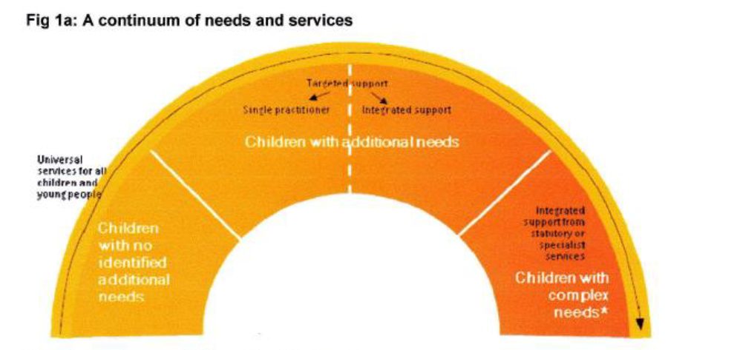
‘Progressive Universalism’

Slide 22
A practice dilemma? An ethical obligation?
Engaged Not At Risk
‘On Track’
Not Engaged Not At Risk
‘On Track’
Engaged At Risk
Child developmentally at risk or developmentally vulnerable
Not Engaged At Risk
Child developmentally at risk or developmentally vulnerable

Slide 23
Thank you
For more information please contact:
Belinda Whitelaw – Best Start Co-ordinator
belinda.whitelaw@shepparton.vic.gov.au
Sally Wright – Best Start Officer
outsidep@mcmedia.com.au
Chris Widdicombe – MCH Team Leader
chris.widdicombe@shepparton.vic.gov.au

