Slide 1
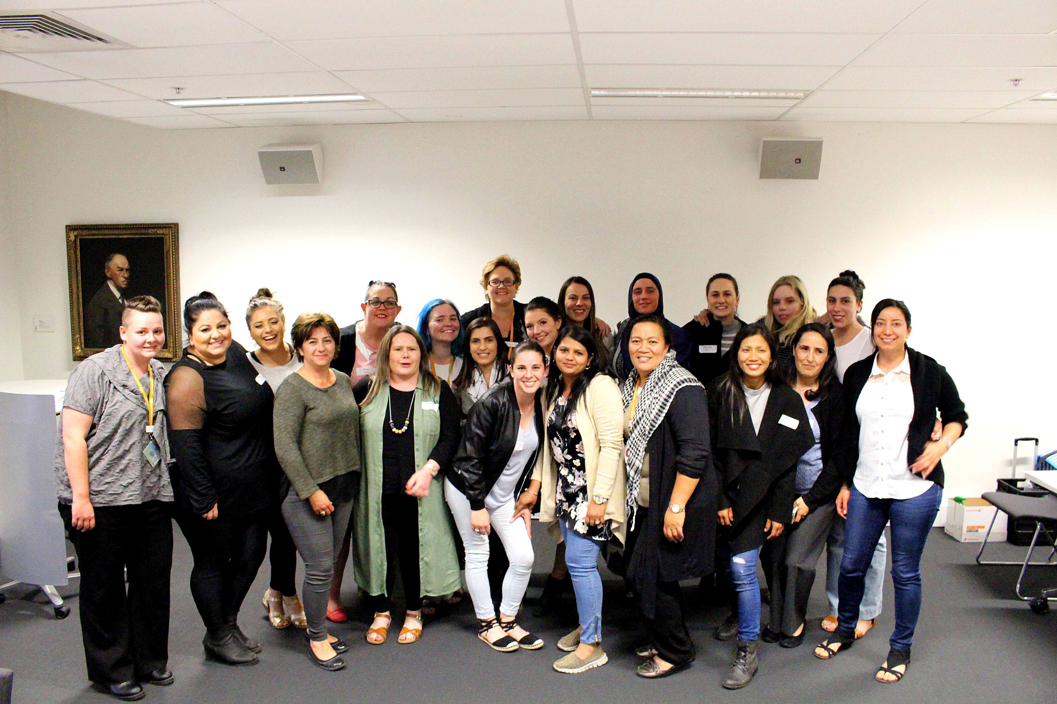
The Gowrie Broadmeadows Valley Team
Notes:
Most work needed on expectations and evidence

Slide 2
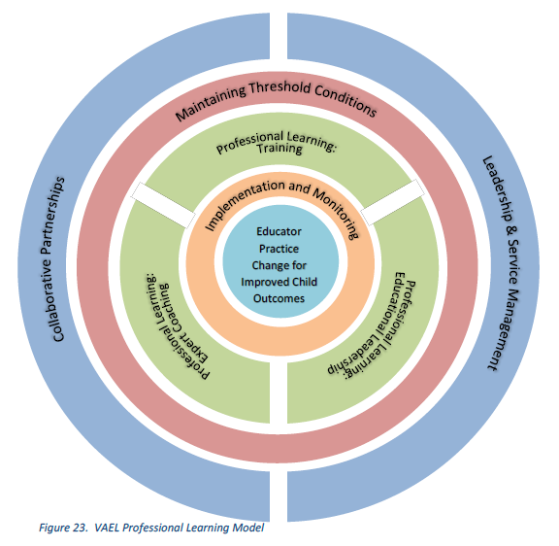
The VAEL Professional Learning Model
Notes:
Most work needed on expectations and evidence

Slide 3
The Gowrie VAEL CLASS Results: Birth - 3
Notes:
Most work needed on expectations and evidence

Slide 4
The Gowrie VAEL CLASS Results: 3-5s
Notes:
Most work needed on expectations and evidence

