Slide 1






23/07/2018
Language Acquisition: Improving Children’s Outcomes through Professional Learning and Collaborative Practice
Patricia Eadie, PhD peadie@unimelb.edu.au
paeadie
Early Childhood Forum, June 2018
Theoretical Background
Child development takes place in a nested structure where systems interact with each other and the child
Developmental outcomes are the result of progressively more complex interactions between the child, their carers, the environment, and the cultural context
(Bronfenbrenner 1979)

Slide 2
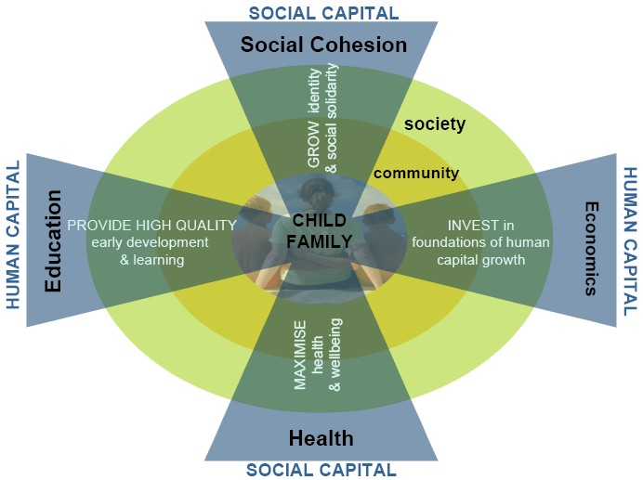
23/07/2018
Children’s Learning and Development
 Context of Learning
 Great variation exists in the environments in which children live and grow
 Interaction of children’s genes and environments has the most significant impact on development
 Play and human relationships form the common context for children’s learning
 Development is
 underpinned by secure attachment, responsive relationships and stimulating language & learning environments
 Based in relationships that occur when young children interact with others to build a platform for advancing children’s learning

Slide 3
23/07/2018
Why Language?
 Essential tool in the process of learning; underpins verbal reasoning and problem solving skills
 Development of social skills & social cognition
 Provides the foundation for literacy and development in both becomes increasingly interrelated
 Key predictor of achievement and social-emotional outcomes; links with adolescent and adult mental health
Sociocultural Theory (Vygotsky & Bruner)
 Language is a social phenomenon.
 Children want to communicate with others.
 Interaction between people of varying levels of expertise (zone of proximal development)
 Children’s social-cognitive abilities mediate language acquisition.
 Focus = Communicative Interaction

Slide 4
23/07/2018
How is Language Learned?
Adults do not attempt to “teach” language directly to typically developing children.
However, they
 provide language input that is adapted to the child’s level of attention and comprehension
 reinforce child attempts in a way that makes it more likely for the child to talk more
 provide repetitions and expansions of child utterances
Interactionist Perspective
 the child is an active learner
 the child is predisposed for learning language
 thinking and talking both enable the child to make sense of her world
 observation and social interaction enable the child to construct social meaning
 the environment exposes the child to the different purposes and contexts of language
 Research demonstrates that it is the human interaction between young children and other people that advances their learning and development
Patricia Kuhl - Llinguistic Genius of Babies

Slide 5
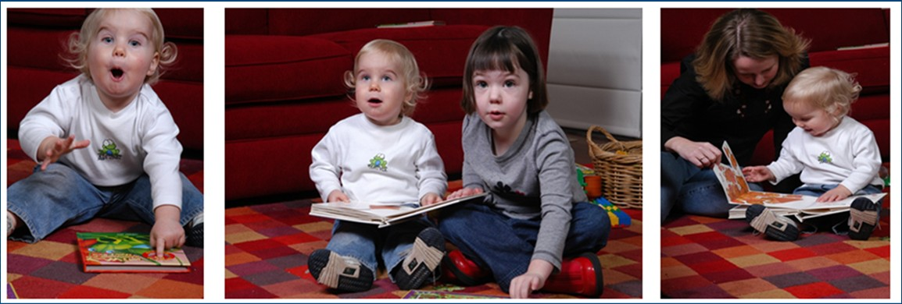
23/07/2018
Adult Interaction Supporting Language Development
Intentionality: toddlers influencing the listener
 Behaviour regulation: protesting or requesting an object or action
 Social interaction: drawing attention to self for the purpose of interacting
 Joint attention: getting another’s attention in order to comment on objects and events
Bruner 1977 & 1983; Prizant & Wetherby 2003

Slide 6
23/07/2018
Fundamental Elements of Vocabulary Development:
The quantity of the vocabulary children hear at home and in early childhood settings.
The sophistication of the words children are exposed to
 Less frequent or rare words add to vocabulary
The conversational support provided by adults in communication interactions.
 Extend conversations; sustain turns on a topic
 Add vocabulary & grammar to what children say
Use of Sophisticated Vocabulary
 Over 1 million words in English
 Average vocabulary size is 20,000 words
 Low-frequency vocabulary = abstract, semantically complex, sophisticated
Weizman & Snow 2001
 Conversations: mother-child (3-5 yrs)
 total different words 2,871 (900-5779); sophisticated words 23 (1-78)
 99% of vocabulary used with young children is from the 3000 most frequently used
 ↑ quantity is related to ↓ in variability in vocabulary

Slide 7
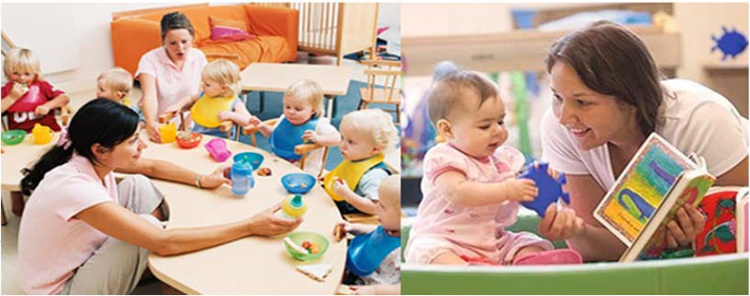
23/07/2018
Every day with Every child in Every situation Language is used
 Conversation during caregiving activities
 Sharing books
 Storytelling
 Songs & rhymes
 Discussions & Investigations
 Dramatic Play
 Instructions & Requests
 Questions
Changing Children’s Developmental Outcomes
 Increasingly learning and development are seen to be strongly affected by relatively small shifts in the learning environment
for example, conversational exchange or caregiver responsivity
 Demonstrated by Home Learning Environment Programs:
 Nurse Home Visiting Programs
 Demonstrated by Early Childhood Model Programs:
 Carolina Abecedarian Project
 High Scope Perry St Program
 Intensity and Dosage

Slide 8
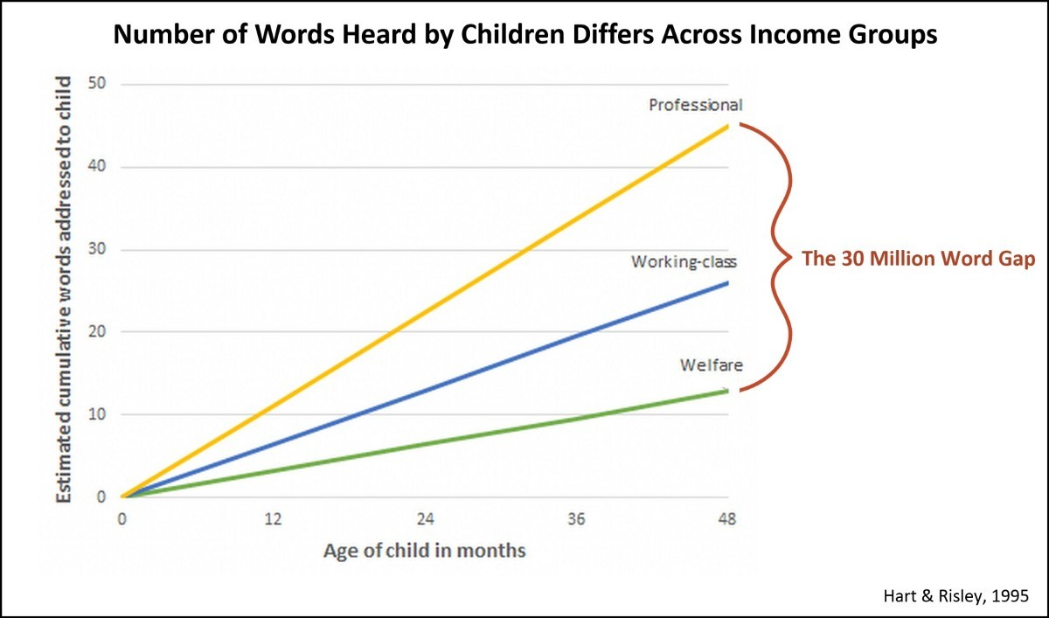
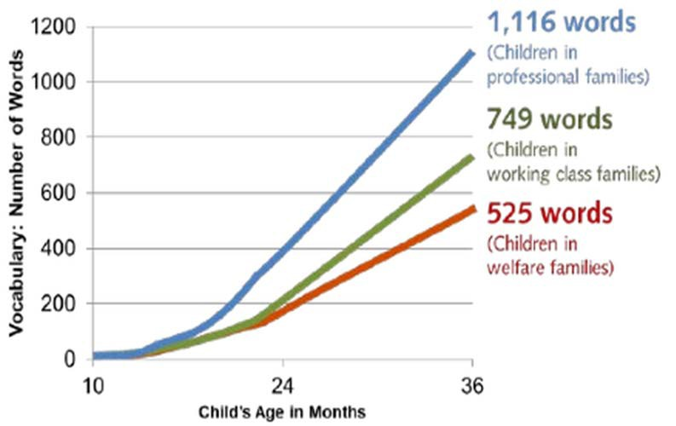
23/07/2018
Achievement Gaps Start Early
Achievement Gaps Start Early
Hart & Risley 1995

Slide 9
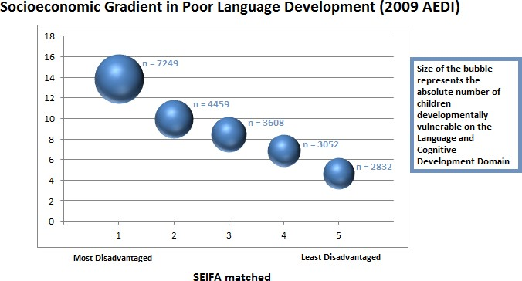
23/07/2018
Absolute and Relative
Slide from S. Brinkman presentation in AEDI Master Class, February 2014
Percent of children vulnerable
School Readiness Skills by Socioeconomic Group
 | Lowest SES | Highest SES
Recognising letters of alphabet | 39% | 85%
Identifying beginning sounds of words | 10% | 51%
Identifying primary colours | 69% | 90%
Counting to 20 | 48% | 68%
Writing own name | 54% | 76%
Amount of time read to prior to school | 25 hrs | 1000 hrs
Accumulated experience with words (vocabulary) | 13 million | 45 million
Neuman, S.B. The Knowledge Gap: Implications for Early Education (2006)
Sources: Lee & Burkham (2002), Adams (1990), Hart & Risley (1995)

Slide 10
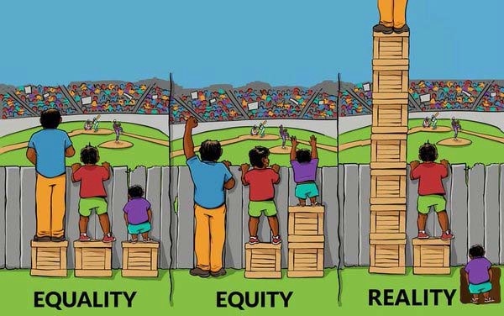
23/07/2018
Equality and Equity
Proportionate Universalism
 where programs, services and policies are provided to all children and families but with a scale and intensity that is proportionate to the level of need and vulnerability of individuals
 Marmot M. Fair Society, Healthy Lives: The Marmot Review. London: Strategic Review of Health Inequalitites in England post-2010; 2010.

Slide 11
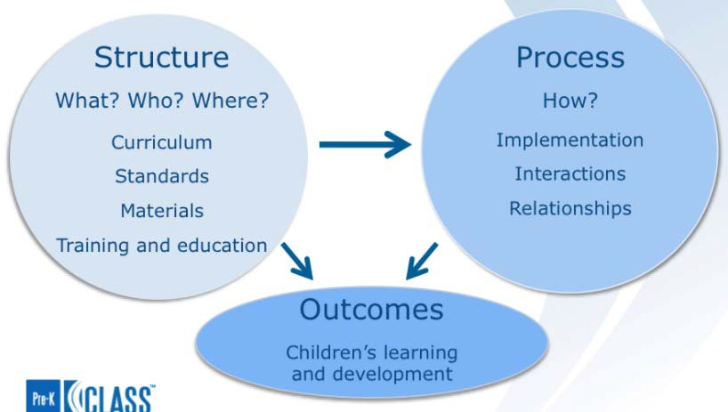
23/07/2018
Short & Long-term Effects of High-Quality Early Education Experiences
 the existing research suggests expanding high-quality early learning initiatives can impact children’s developmental trajectories and would provide significant benefits to society beyond the initial investment
 Yazejian, N., Bryant, D. M., Hans, S., Horm, D., St Clair, L., File, N., & Burchinal, M. (2017). Child and Parenting Outcomes After 1 Year of Educare. Child Dev. doi:10.1111/cdev.12688
 Bakken, L., Brown, N., & Downing, B. (2017). Early Childhood Education: The Long-Term Benefits. Journal of Research in Childhood Education, 1-15. doi:10.1080/02568543.2016.1273285
 Economics of Early Childhood Investments (2014). Executive office of President of the United States of America.
Factors that Influence Quality in ECEC
Adapted from Pianta, La Paro & Hamre (2008) Classroom Assessment Scoring System

Slide 12
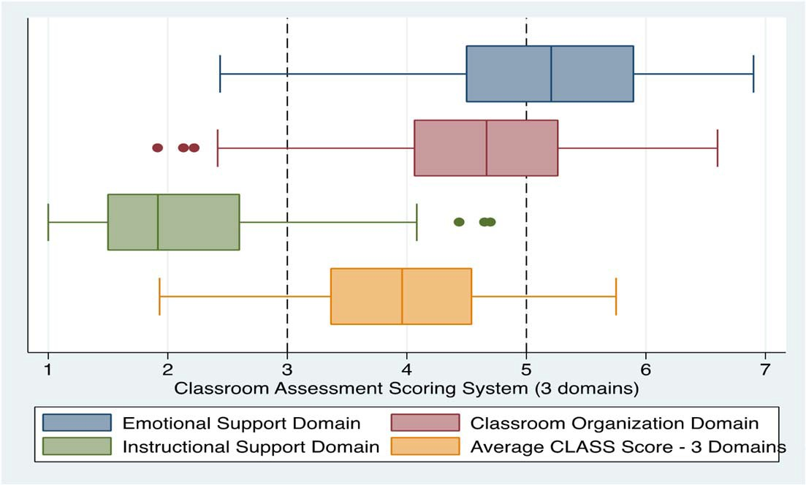


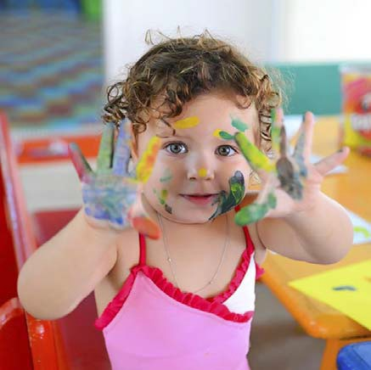

23/07/2018
E4Kids Study
Process Quality Measured by CLASS
QA 5
QA 1
EVERY TODDLER TALKING

Slide 13

23/07/2018
Every Toddler Talking Research Aims
 strengthen early childhood (EC) educators’ practice to promote all children’s language and communication development (birth to three)
 creating the opportunity for collaboration between EC educators and speech pathologists
 improve language and communication outcomes for babies and toddlers
Every Toddler Talking
Learning Language and Loving It©
Weitzman and Greenberg, 2002
 8 x face to face professional learning sessions
 6 x individual video coaching sessions
 mapping of LLLI© goals to the Victorian Early Years Learning and Development Framework (VEYLDF) and to the National Quality Standards (NQS)
 ongoing collaborative working groups.

Slide 14
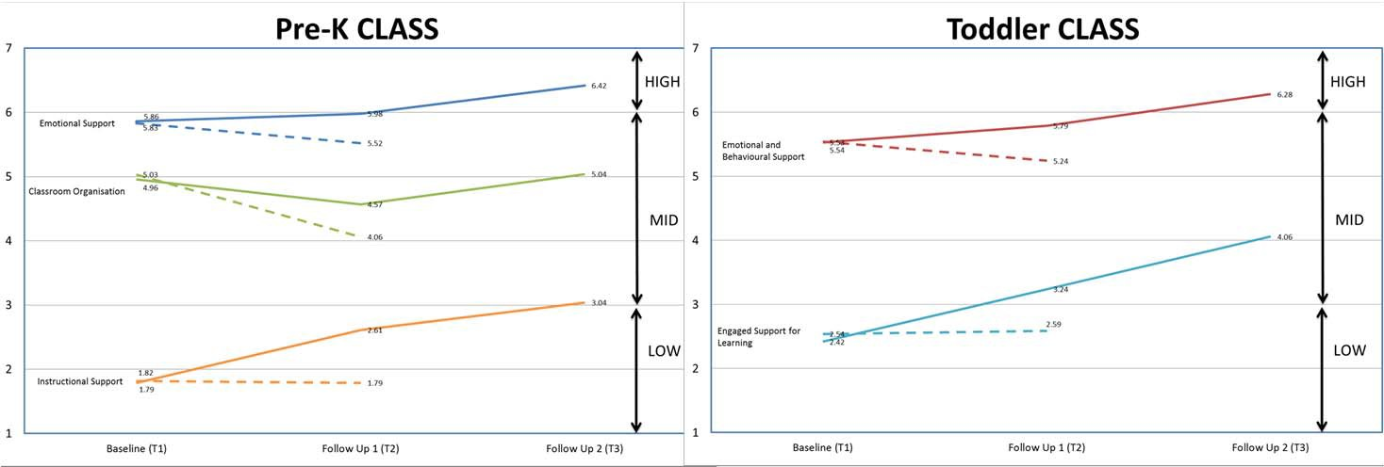
23/07/2018
Every Toddler Talking: Professional Learning Outcomes
Every Toddler Talking – Key Learnings
 Early childhood educators’ knowledge, practice and professional identities were strengthened
 Video coaching was highly valued – impact on self-awareness and self-reflection
 Strong collaborative relationships between early childhood educators and speech pathologists were established
 The positive impact of collaboration and professional learning at multiple tiers of early childhood education and community health services

