Slide 1


Slide 2

Review background and process
Review focus: early childhood education and school outcomes
Key recommendations
Action!

Slide 3

Commissioning and timeframe
Consultations
Research

Slide 4


Slide 5
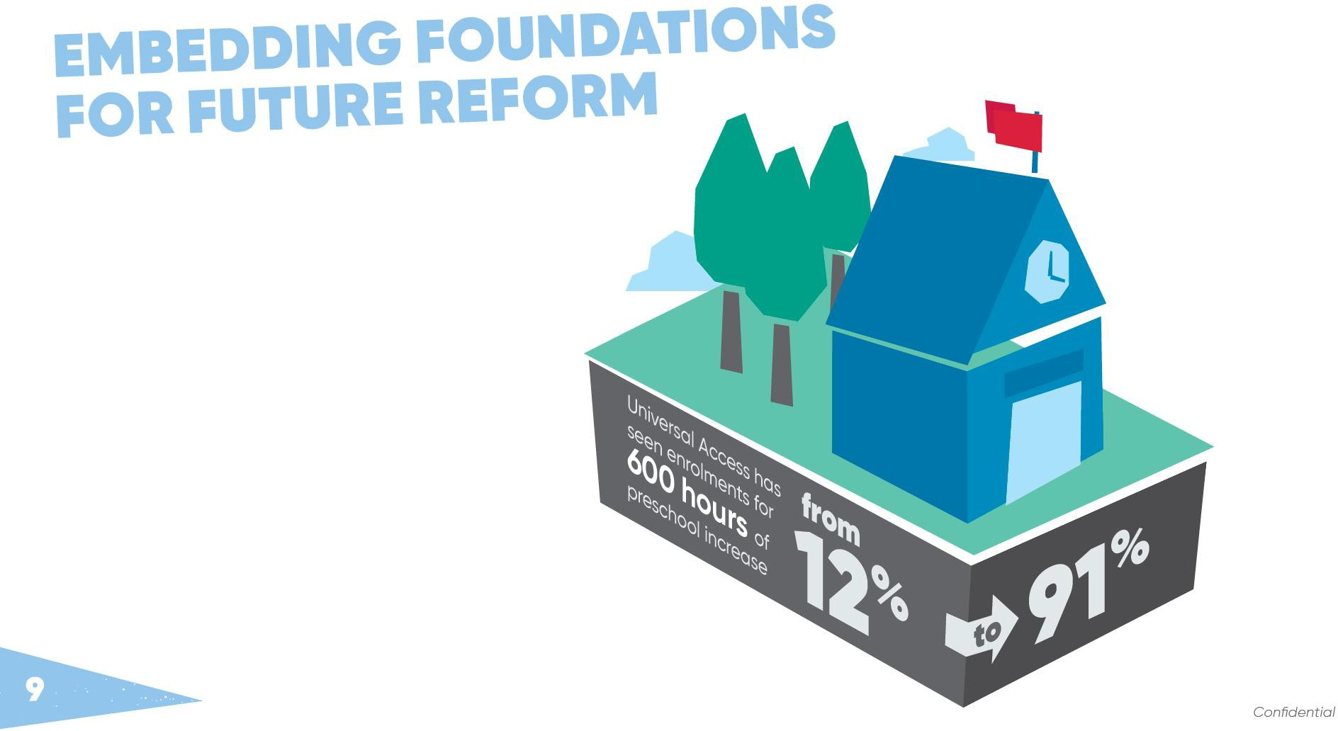
Recent reform has been important, and needs to be made permanent.

Slide 6

Two years of early childhood education is of significant benefit to children.
Australia trails the OECD field

Slide 7
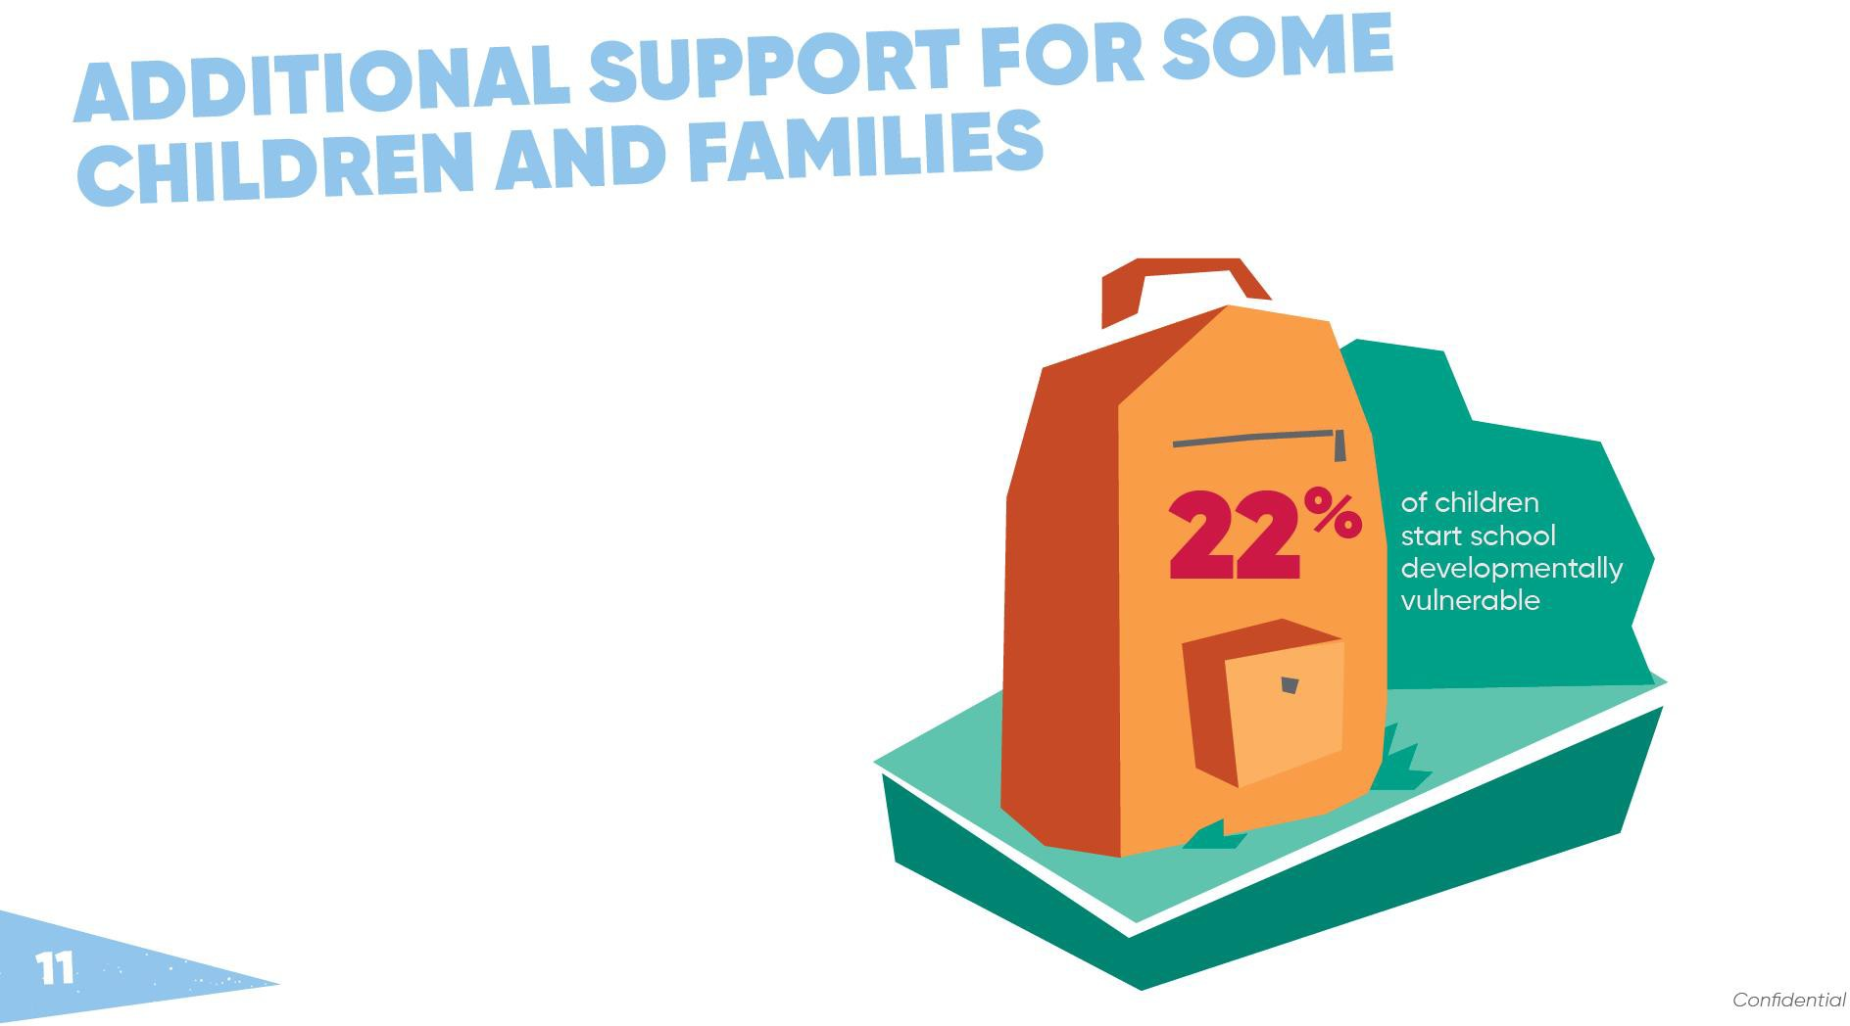
Children who start school behind stay behind,
so should get more
help earlier.

Slide 8
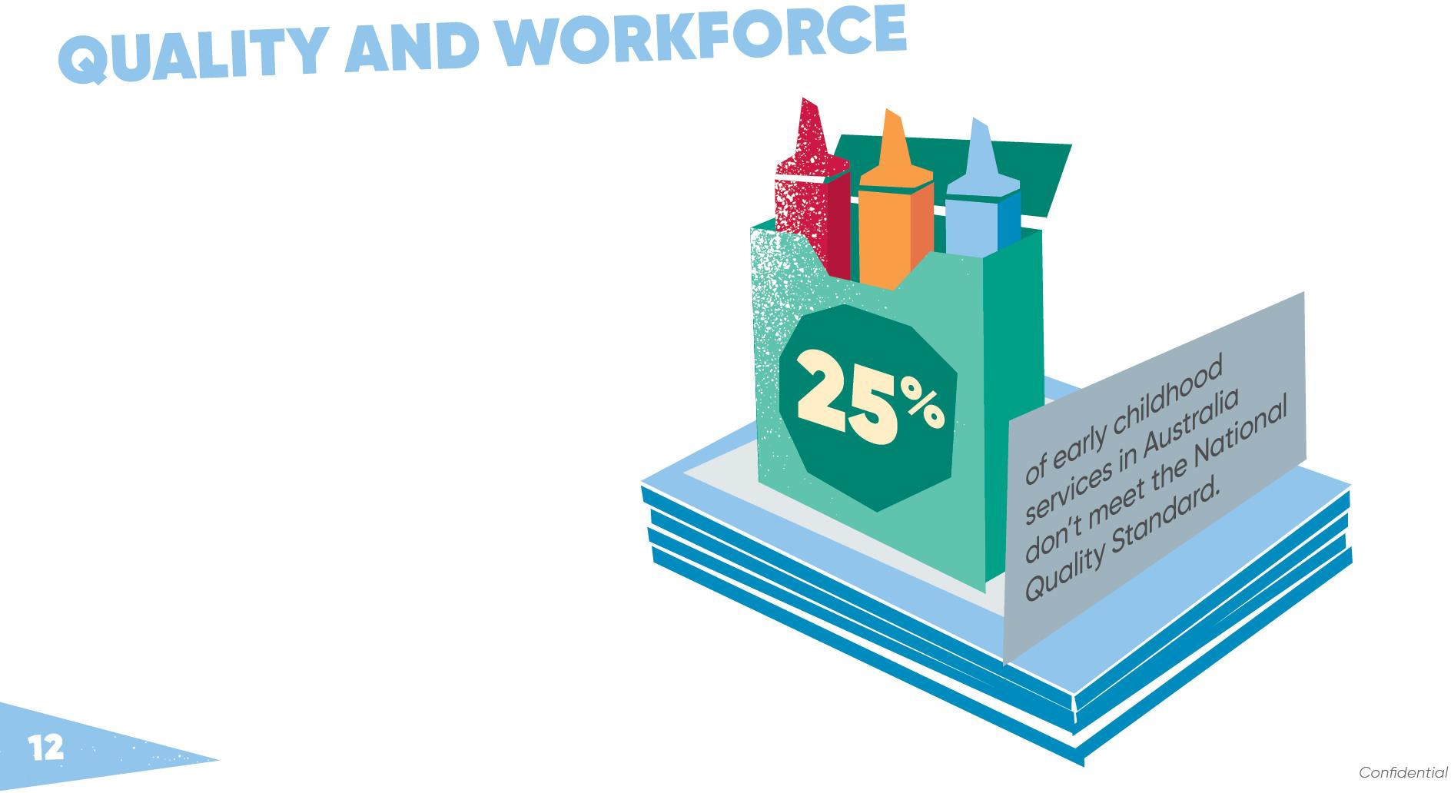
Workforce and service quality are vital to improving outcomes.

Slide 9

Parents are vital to the health, wellbeing,
learning and development of their child.

Slide 10
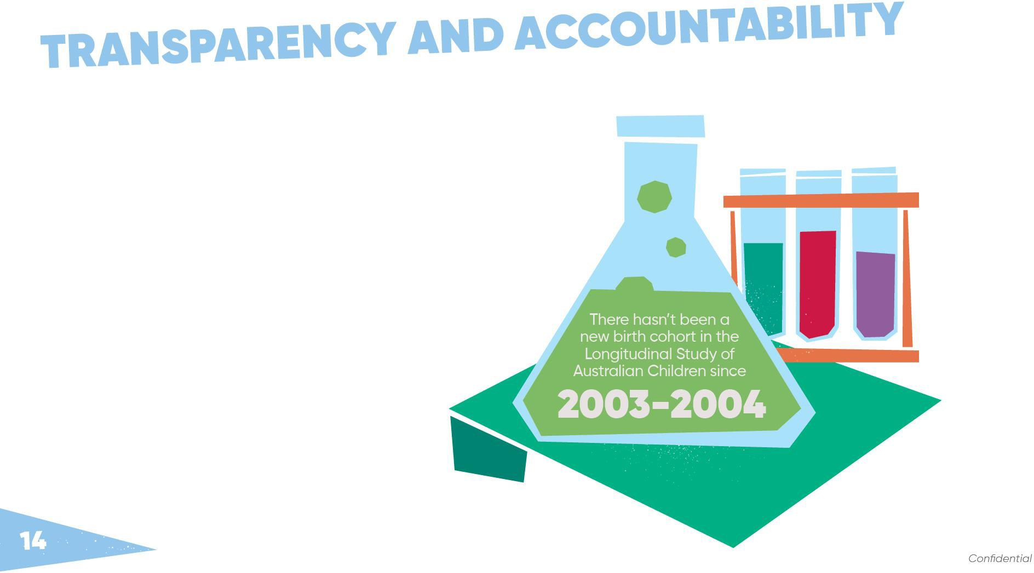
High quality data is needed to improve policy and practice.

Slide 11


Slide 12


