Slide 1


A better early years system: Towards holistic policy and practice
REALISING THE POTENTIAL: EARLY CHILDHOOD FORUM
FRIDAY 8 JUNE 2018
Dr Charlene Smith – Policy Program Director
Charlene.Smith@vu.edu.au @charleesarah @MitchInst

Slide 2
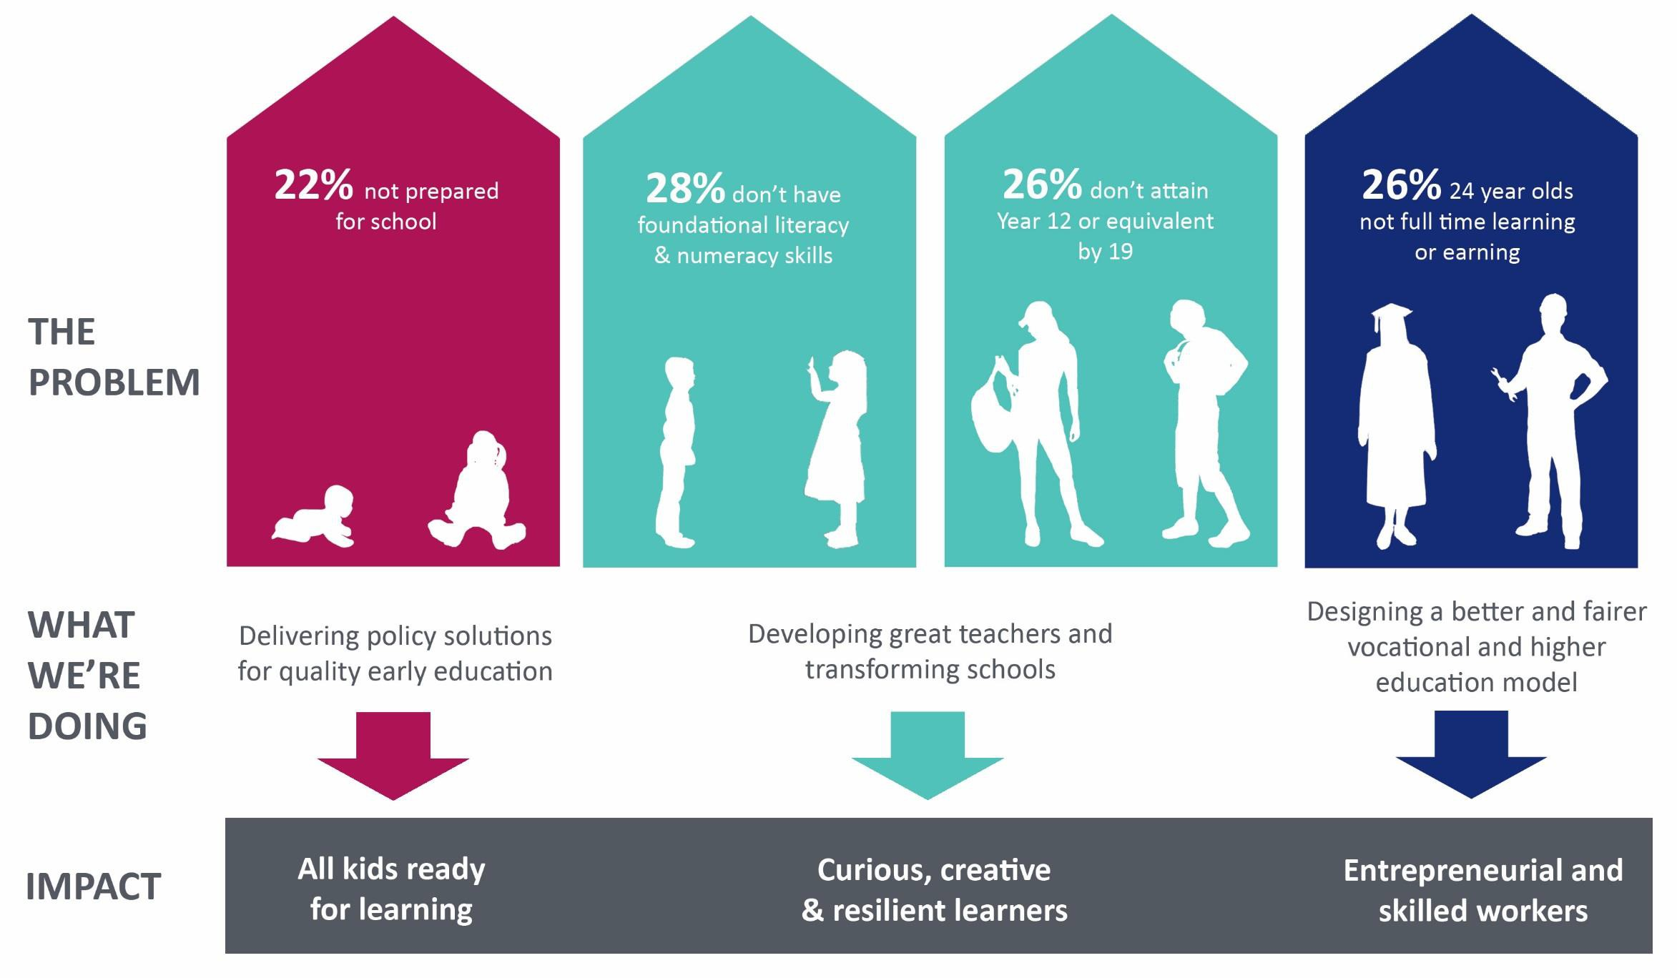
Mitchell Institute – focus on policy & impact
2

Slide 3






Stakeholder landscape
Workforce
Advocacy
Policy
ECE provision
Funding
Service system
Research

Slide 4
The early years policy context: Federal
Education
Health
Social services
Prime Minister and Cabinet
Human Services
Prime Minister's Community Business Partnership - First 1000 Days
Child care subsidy
Funding for health services
Programs and services
Payments for families
Grants and funding to service organisations
Centrelink, Medicare & Child support
National partnerships
Programs
Indigenous Affairs
Domestic and Family Violence support services
Frameworks and standards

Slide 5



State and territory policies and services
Early learning
Provision and funding of universal access to preschool / kinder
Regulatory authorities – National Quality Standards
Libraries, play groups, child and family centres
Child health and development
Perinatal health care, maternity services, maternal and child health (MCH) nursing, immunisation
Hospitals, community health, allied health
Mental health services, drug
and alcohol treatment
Social services
Early intervention, statutory and support services: child protection; disability; mental health; housing and homelessness; domestic and family violence

Slide 6

What do young children need?
Provided with:
Care and communication
Safe environments
Health and nutrition
Protected from:
Abuse, neglect, toxic stress
Poverty, environmental hazards
"Children's early years offer a rare window for societies to make investments in their children with extremely high returns. Efforts to improve children's lives can significantly increase individual and societal productivity while reducing inequality"
(World Bank, 2018).

Slide 7
What works in the early years?
Strongest evidence base:
Preschool programs
Home visiting
Parent education BUT
No silver bullets – small to moderate effect sizes
Not enough to close gaps
Need ongoing efforts to sustain effects

Slide 8
Why universal?
Reduced
barriers
A place for every child
Universal approaches
Social benefits
Equity, access and inclusion

Slide 9

What about targeted approaches?
Child- centred
Responsive
Strategic

Slide 10
Thank you
Educational opportunity in Australia 2015: Who succeeds and
who misses out
http://www.mitchellinstitute.org.au/reports/educational-opportunity-in-australia-2015- who-succeeds-and-who-misses-out/
Quality Early Education for All
  www.mitchellinstitute.org.au/reports/quality-early-education-for-all
Charlene.Smith@vu.edu.au
@charleesarah
10

