Slide 1
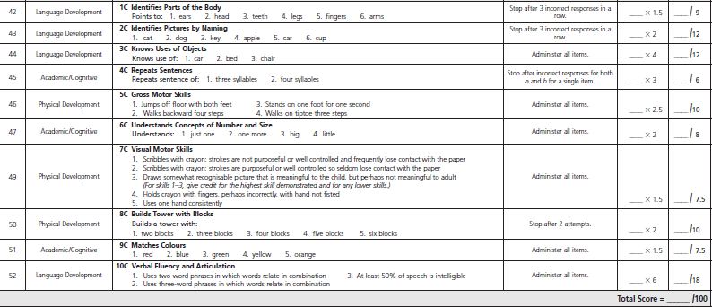
BRIGANCE® Screen III Two-Year-Old Child Data Sheet COLOUR CODED BY DOMAIN
Language= lemon
Physical
= purple
Academic= aqua
Max domain score |  | Domain score below average
 |  | 2-0 to 2-2 | 2-3 to 2-5 | 2-6 to 2-8 | 2-9 to 2-11
Language 51 |  | ≤ 22 | ≤ 32 | ≤ 36 | ≤ 40
Physical 27.5 |  | ≤ 15 | ≤ 17 | ≤ 20 | ≤ 21
Academic 21.5 |  | ≤ 7 | ≤ 11 | ≤ 13 | ≤ 17
Cut off Score
2-0 to 2-2 | 2-3 to 2-5 | 2-6 to 2-8 | 2-9 to 2-11
< 47 | <54 | <62 | <75
Brigance® Screens III: Technical Manual • CA14300 • © 2014. p 107, 146-149 All rights reserved.

Slide 2
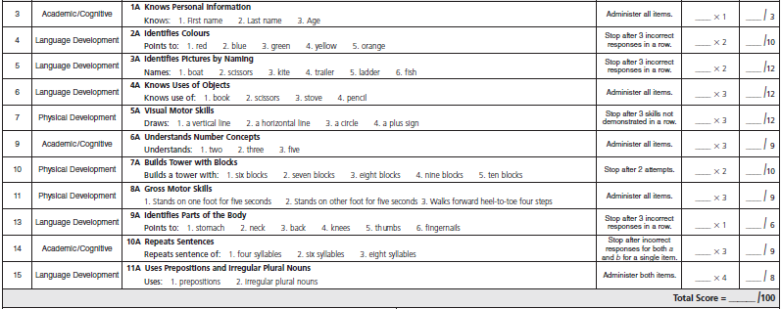
BRIGANCE® Screen III Three-Year-Old Child Data Sheet COLOUR CODED BY DOMAIN
Language= lemon
Physical
= purple
Academic= aqua
Max domain score |  | Domain score below average
 |  | 3-0 to 3-3 | 3-4 to 3-7 | 3-8 to 3-11
Language 48 |  | ≤ 22 | ≤ 25 | ≤ 36
Physical 31 |  | ≤ 13 | ≤ 16 | ≤ 19
Academic 21 |  | ≤ 5 | ≤ 7 | ≤ 11
Cut off Score
3-0 to 3-3 | 3-4 to 3-7 | 3-8 to 3-11
< 42 | < 45 | < 49
Brigance® Screens III: Technical Manual • CA14300 • © 2014.
p 107, 150-153. All rights reserved.

