Slide 1
KINDERGARTEN IN [LGA NAME LIKELY TO BREAK TWO LINES]
Council branding here
REGISTER
RECEIVE UPDATES
CONFIRM YOUR PLACE
ENROL AT KINDER
Online at [link to CRES landing page]
Paper form from your local council, kinder, MCH or support services.
We will keep you updated while we find you a kindergarten place.
Once you are happy with your offer, let us know.
Your kinder will get in contact to help you enrol.
WHY SHOULD MY CHILD GO TO KINDER?
Kindergarten is great for all children! Kindergarten helps children meet their social, emotional, physical and cognitive needs. It sets your child on a path of learning for life. Kindergarten is also a great way for you and your child to make friends in the community.
CONTACT US If you have any questions, or need any help, contact [CRES provider]
E: [email@cresprovider.com]
PH: [phone number]
WHAT KINDER PROGRAMS ARE AVAILABLE?
Type | Age | Hours | Cost
Thee year old kinder | Three by 30 April 2021 | 5-15 hours per week | [Range of prices in scheme]
Four year old kinder | Four by 30 April 2021 | 15 hours per week | [Range of prices in scheme]
HOW DO I GET MY CHILD INTO KINDER?
[CRES provider] makes it easier for you to get your child into kindergarten. Because the registration process is centralised for NN kindergartens in [LGA], you don’t have to waste time filling out many different registration forms.
There are 4 simple steps to get your child into kinder. Key dates for this process are listed in the table on the right.
Date | What happens?
1 March | Registrations open
30 May | Registrations close
Early August | First round offers
Mid-August | Acceptance of first round offers
Early September | Second round offers
Mid-September | Acceptance of second round offers
Weekly/when available | Subsequent offers

Slide 2
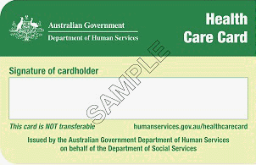
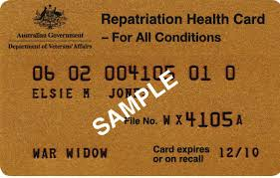
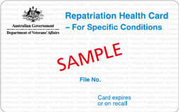
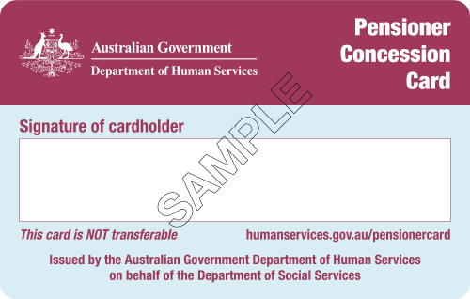
Council branding here
CAN I GET HELP WITH THE COST OF KINDER?
[CRES provider] is committed to helping all children go to kindergarten. If you meet one of the criteria below, your child will be prioritised when places are allocated, and you may be eligible for reduced cost kindergarten.
Criteria – children who | Priority allocation | 15 hours free or low cost 4 y/o kinder | 15 hours free or low cost 3 y/o kinder
Are Aboriginal and/or Torres Strait Islander
Are known to Child Protection
Hold, or have parent or carer who holds a humanitarian or refugee visa
Are a multiple birth child (triplets or more)
Hold, or have a parent or carer who holds a: Commonwealth Health Care Card Pensioner Concession Card Veteran’s Affairs Card
If Funded Three-year-old Kindergarten is operating in your LGA, tick all of the boxes. Children who are eligible for KFS will receive it for Three-Year-Old Kindergarten
CONTACT US If you have any questions, or need any help, contact [CRES provider]
E: [email@cresprovider.com]
PH: [phone number]
Space for QR code if using

